Slide 1
FD-MMAC: Combating Multi-channel Hidden and Exposed Terminals Using a Single Transceiver
Yan Zhang, Loukas Lazos, Kai Chen,
Bocan Hu, and Swetha Shivaramaiah
Electrical and Computer Engineering
University of Arizona
INFOCOM 2014

Slide 2
Channel Access in Multi-channel Wireless Networks
A set of nodes within the same collision domain share access to fixed number of channels
Schedule-based
Contention-based
A
D
E
B
F
C
f3
C - F
E - C
D - E
E - D
f2
B - E
A - B
B - F
B - A
f1
A - D
F - D
C - A
F - C
Notes:
In this work, we address the problem of improving throughput and delay efficiency of distributed multi-channel MAC protocols.
Before we go to multi-channel MAC protocols, let’s look into the channel access problem in multi-channel wireless networks.
2 ways to allocate common resource to multiple pairs: (1) schedule-based where various transmissions are scheduled in freq. and time.
(2) Contention-based allocation. In such mechanism, nodes contend for allocation of available freq. bands in distributed manner.
As an example here, 6 nodes within collision domain, we have 3 available freq. bands here. By coordinating channel access among multiple pairs, various transmissions can take place over the 3 channels in parallel without collisions.
This function is typically achieved by multi-channel MAC protocol.

Slide 3
The Multi-channel Hidden Terminal Problem
f₁
hidden
terminal to A
A
B
C
C
C switches to f₁
backoff
RTS_{C}
t₂
t₃
B
collision
CTS_{B}
A
RTS_{A}
P_{A}
t₀
t₁
Notes:
There are several challenges in designing a multi-channel MAC protocol. The first challenge is the multi-channel hidden terminal problem. Suppose A wants to communicate with B on channel f1, and C is a hidden terminal to A. A and B first perform RTS-CTS exchange, after which A transmits a data packet PA to B, let’s say PA begins at time t0 and ends at t1. If during transmission of PA, C also switches to f1 at time t2. In this case, C misses the chance to hear CTS and thus determines f1 to be idle because it is out of A’s transmission range. After proper backoff, C also initiates an RTS to B at time t3, which causes a collision at B.

Slide 4
The Multi-channel Exposed Terminal Problem
f₁
exposed
terminal to B
A
B
C
D
C switches to f₁
C
C defers transmission
t₂
B
RTS_{B}
P_{B}
t₀
t₁
A
CTS_{A}
Notes:
The second challenge is the multi-channel exposed terminal problem. Suppose node B wants to communicate with A on f1, and C is an exposed terminal to B. To communicate, B and A first perform RTS-CTS exchange, after which data packet PB is transmitted. Suppose C switches to f1 during PB’s transmission, C is not able to know it is in exposed terminal location due to missing RTSB. As a result, C defers its transmission to D due to sensing the transmission of PB.
(On a single channel, node C can identify itself as an exposed terminal to B if it only hears RTS but not CTS. However, when there are multiple channels, C may not be able to know this information.)
There are also other challenges in designing multi-channel MAC, such as destination discovery and load balancing. I will talk about how we address these problems in detail later.

Slide 5
Prior-Art on Multi-channel MAC (MMAC)
Split-phase designs (SP-MMAC)
f3
Data
f2
Data
f1
REQ
ACK
RES
REQ
ACK
RES
REQ
ACK
RES
Data
control phase
data phase
Dedicated control channel designs (DCC-MMAC)
f3
Data
f2
Data
Data
f1
REQ
ACK
RES
REQ
ACK
RES
REQ
ACK
RES
Frequency hopping rendezvous designs (FH-MMAC)
Notes:
Krunz: “For SP-MMAC, control phase fixed duration is not really a limitation for MMAC, control phase can be adjusted.”
Common disadvantages of DCC-MAC and SP-MMAC: 1. Use of control channel decreases spectral efficiency; 2. Control channel saturation; 3. Control channel single point of failure.
SP-MMAC: a node needs to wait for next control channel if (1): the node does not successfully reserve a channel during control phase, or (2) a node changes its destination in the middle of a data phase.
FH-MMAC: does not address the hidden/exposed terminal problem.

Slide 6
Full-Duplex Multi-Channel MAC (FD-MMAC)
Design a distributed MMAC protocol that:
Eliminates the use of a control channel
Combats the multi-channel hidden terminal problem
Reduces control signaling
Improves spectral efficiency by enabling the operation of
exposed terminals
Achieves load balancing and fairness autonomously
Notes:
Split-phase:

Slide 7
Communication in Full-Duplex (FD) Mode
MAC for Multi-channel Networks ( MMAC)
BCN_{B}
A
B
P_{A}
B
BCN_{B}
BCN_{B}
BCN_{B}
BCN_{B}
ACK_{B}
t_{ACK}
A
PHY
MAC
P_{A}
t_{e}
BCN_{B}:
PHY
ID_{B}
t_{ACK}
CRC
Notes:
The FD operation mode is one of the key ideas of our FD-MMAC protocol. This example shows how nodes utilize FD to communicate in FD-MMAC.

Slide 8
FD Carrier Sensing
MAC for Multi-channel Networks ( MMAC)
CO
TO
RO
BCN_{B}
A
B
C
C
P_{A}
C
TO: Transmitter-only region
- P_{A} decodable
- Exposed terminal
RO: Receiver-only region
- BCN_{B} decodable
- Hidden terminal
CO: Collision region
- No packet decodable due
to collision of P_{A} with BCN_{B}
C is only allowed to transmit in TO region
Notes:
Here is how region is classified regarding to an ongoing transmission A-B. To achieve this region classification, one practical issue is how to efficiently evaluate decodability of data packet.

Slide 9
Region Classification Rules
MAC for Multi-channel Networks ( MMAC)
RSS < γ_{RSS}
EVM < γ_{EVM}
BCN=Yes
Use BCN decodability to
differentiate RO from TO/CO
BCN=No
TO
CO
RO
Use EVM measurement to
differentiate TO from CO
BCNB
C₁
A
B
C₄
PA
Capture effect: C may have a low EVM at C₂
capture effect
C₂
C₃
Use RSS to differentiate C₁ from C₂
EVM < γ_{EVM}
If RSS is beyond threshold,
C assumes it is in the CO
BCN=No
BCN=No
RSS > γ_{RSS}
EVM > γ_{EVM}
Notes:
Incorporating the EVM measurement, we are able to set the region classification rules.
Nodes have lower EVM in TO/RO region compared with CO region.
Another practical issue is capture effect.

Slide 10
Combating Multi-channel Hidden Terminals
MAC for Multi-channel Networks ( MMAC)
BCN_{B}
hidden
terminal to A
A
(f₁)
B
C
P_{A}
C
C switches to f₁
t₂
sense
defer
B
BCN_{B}
BCN_{B}
BCN_{B}
BCN_{B}
ACK_{B}
A
PHY
MAC
P_{A}
t₀
t₁
t
Notes:
With FD carrier sensing, multi-channel hidden terminals are practically eliminated.
By decoding BCN_{B}, C infers itself in RO region and defers from transmission
In case BCN_{B} cannot be decoded, C is expected to have high EVM, C then infers itself
in CO region and still defers from transmission.
C is in RO in practice, but may infer itself in CO but this is ok.
Absence of BCN packet indicates collision of PHY and MAC headers due to hidden terminal - Sender aborts further transmission and retransmit.

Slide 11
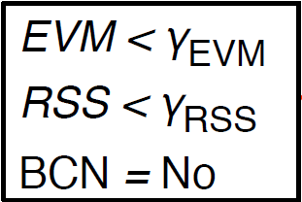
Enabling Exposed Terminal Transmissions
MAC for Multi-channel Networks ( MMAC)
TO
CO
RO
P_{C}
P_{A}
D
(f₁)
C
A
(f₁)
B
BCN_{D}
BCN_{B}
A
PHY
MAC
P_{A}
B
BCN_{B}
BCN_{B}
BCN_{B}
ACK_{B}
C
t₂
sense
backoff
PHY
MAC
P_{C}
D
BCN_{D}
BCN_{D}
BCN_{D}
ACK_{D}
C switches to f₁
TO region
Notes:
FD-carrier sensing also enables parallel transmission at exposed terminals.
Transmission A→B occurs first
C is in the TO region of transmission A→B,
thus can attempt to communicate P_{C} to D
If D can decode the MAC header of P_{C}, D
responds with BCN_{D}
C continues the transmission of P_{C} upon
detecting BCN_{D}, abort otherwise
Transmissions A→B and C→D take place
concurrently without interfering each other

Slide 12
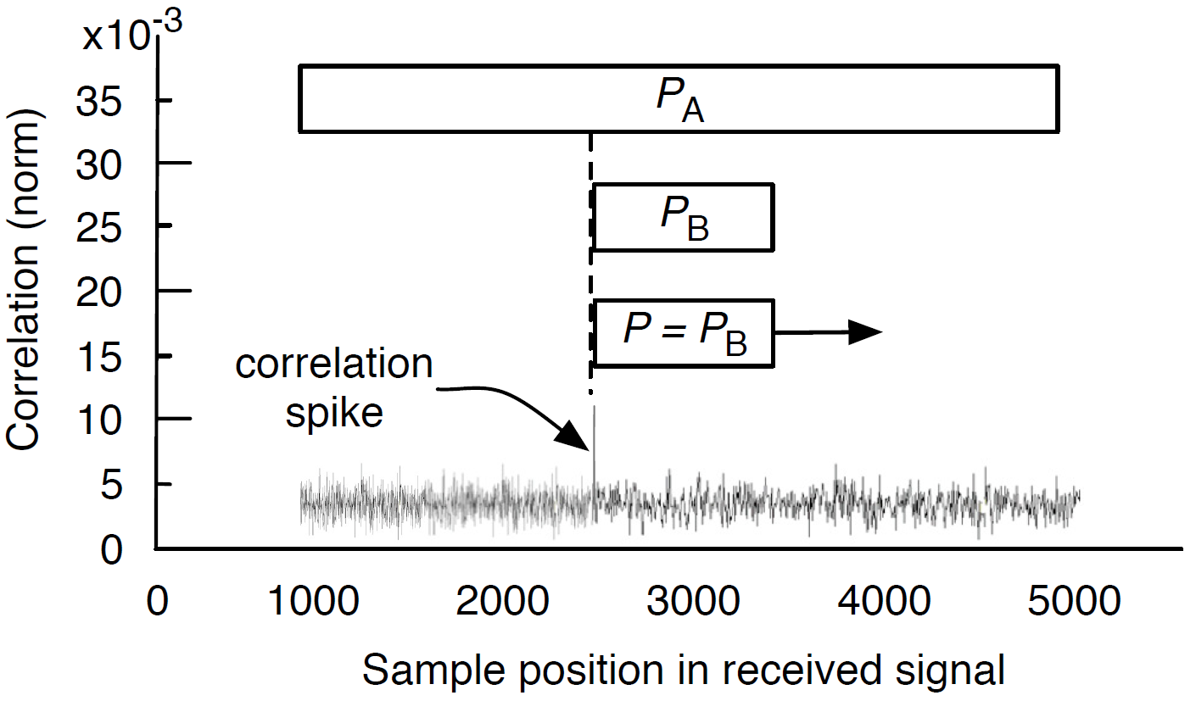
RF Signal Correlation
Detect known bit patterns in the presence of collisions
P_{C}
ACK_{B}
C
A
B
P_{C}
BCN_{D}
ACK_{B}
ACK_{B}

Slide 13
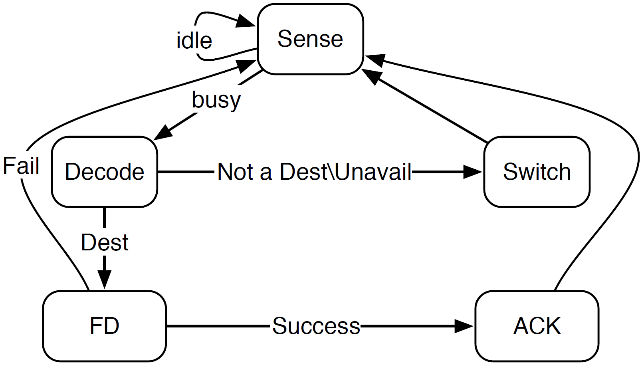
Destination’s State Diagram
MAC for Multi-channel Networks ( MMAC)
A contention-based, time-slotted protocol based on CSMA/CA
No control message overhead related to virtual carrier sensing
Switch channel based on
Channel State Table (CST)
Notes:
Destination discovery and load balancing

Slide 14
Destination Operation Example
MAC for Multi-channel Networks ( MMAC)
f₁
Channel State Table
at destination E
A
B
Channel # | Idle time
f₁ | t_{curr}
f₂ | t_{curr}
f₃ | t_{curr}
f₄ | t_{curr}
(f₁)
E
E is in RO region of A-B
(BCN_{B} decodable)

Slide 15
Destination Operation Example
MAC for Multi-channel Networks ( MMAC)
f₁
Channel State Table
at destination E
A
B
Channel # | Idle time
f₁ | t_{ACK}
f₂ | t_{curr}
f₃ | t_{curr}
f₄ | t_{curr}
(f₁)
E
(f₂)
f₂
C
D
E is in RO region of A-B
(BCN_{B} decodable)
E updates f₁’s idle time
using t_{ACK} in BCN_{B}
E switches to f₂ because
f₂ has earliest idle time
E is in TO region of C-D
(cannot decode BCN_{D})

Slide 16
Destination Operation Example
MAC for Multi-channel Networks ( MMAC)
f₁
Channel State Table
at destination E
A
B
Channel # | Idle time
f₁ | t_{ACK}
f₂ | t_{curr}+t_{MTU}
f₃ | t_{curr}
f₄ | t_{curr}
E
(f₂)
f₂
C
D
E is in RO region of A-B
(BCN_{B} decodable)
E updates f₁’s idle time
using t_{ACK} in BCN_{B}
E updates f₂ ’s idle time
using worst-case estimate
E switches to f₂ because
f₂ has earliest idle time
E switches to f₃
which is currently idle
E is in TO region of C-D
(cannot decode BCN_{D})

Slide 17
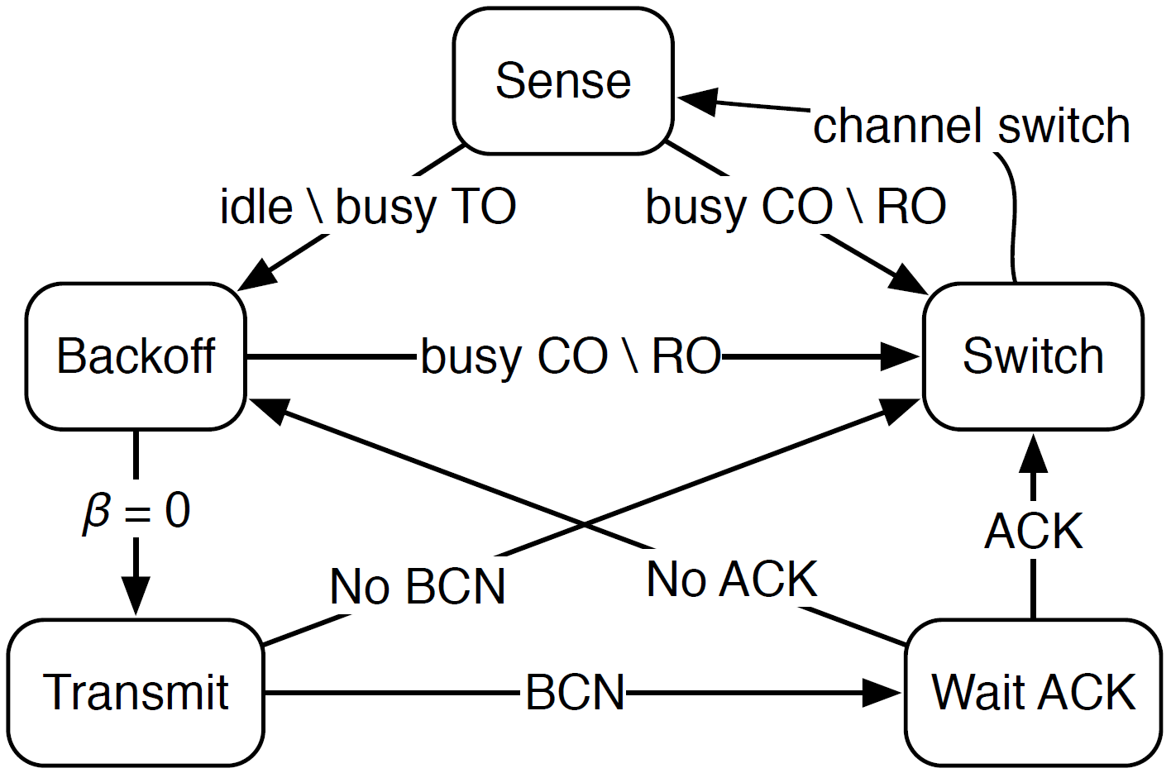
Sender’s State Diagram
MAC for Multi-channel Networks ( MMAC)

Slide 18
Protocol Operation Example
MAC for Multi-channel Networks ( MMAC)
TO
CO
RO
P_{A} (f₁)
C
D
A
B
BCN_{B}(f₁)
P_{C} (f₁)
A
PHY
MAC
P_{A}
B
BCN_{B}
BCN_{B}
BCN_{B}
ACK_{B}
C
sense
backoff
PHY
MAC
switch
sense
PHY
MAC
P_{C}
D
D resides in f₂
early termination
BCN_{D}
BCN_{D}

Slide 19
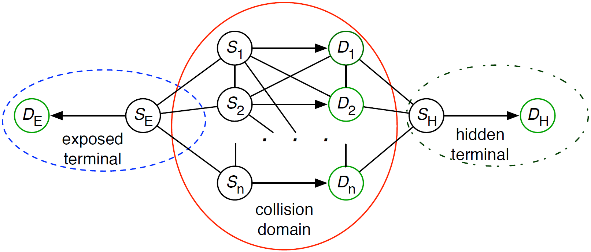
Performance Evaluation
Simulation setup (OPNET)
3 orthogonal channels of 2Mbps
Poisson distributed traffic with parameter λ
Protocols to compare: FD-MMAC SP-MMAC, and DCC-MMAC
Simulated topology

Slide 20
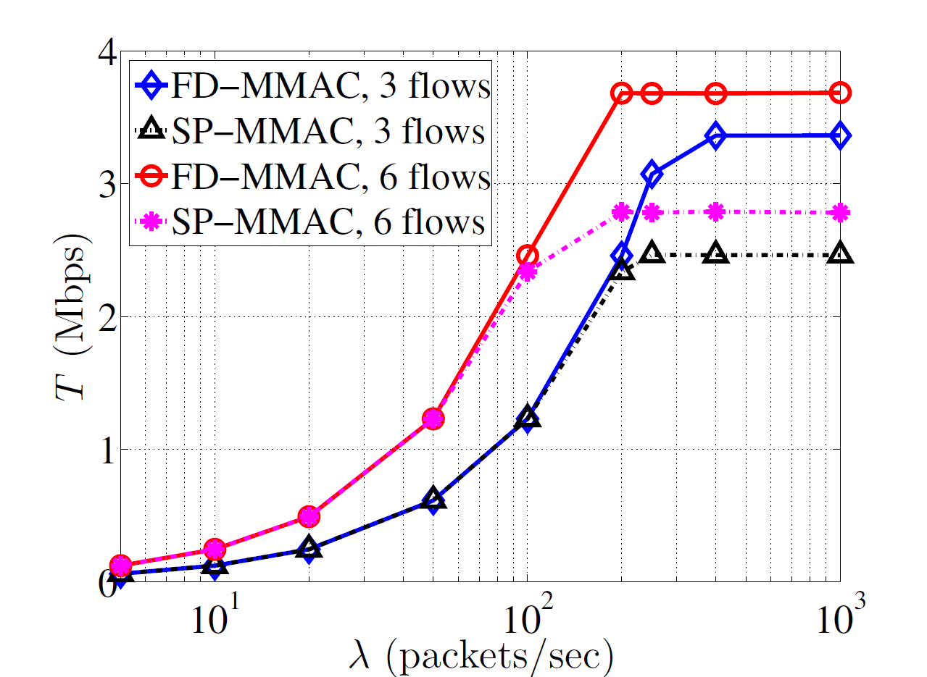
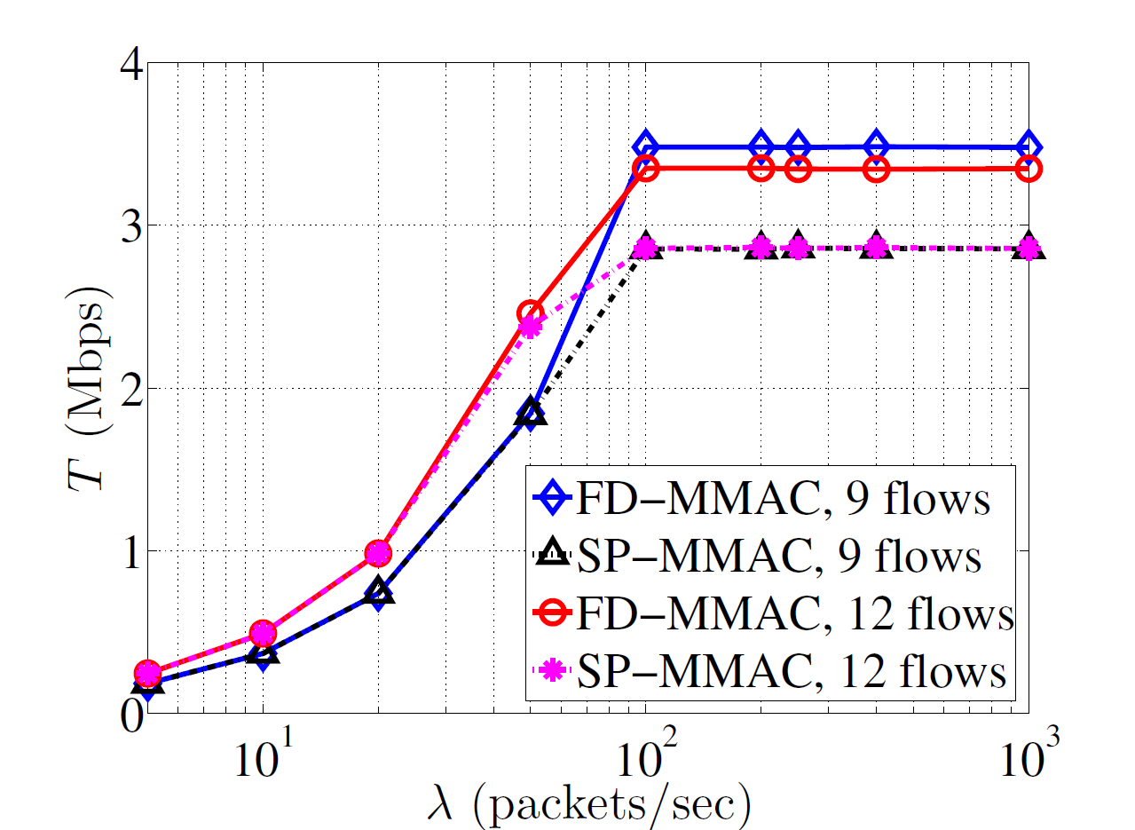
Aggregate Throughput – Single Collision Domain
3, 6 flows
9, 12 flows

Slide 21
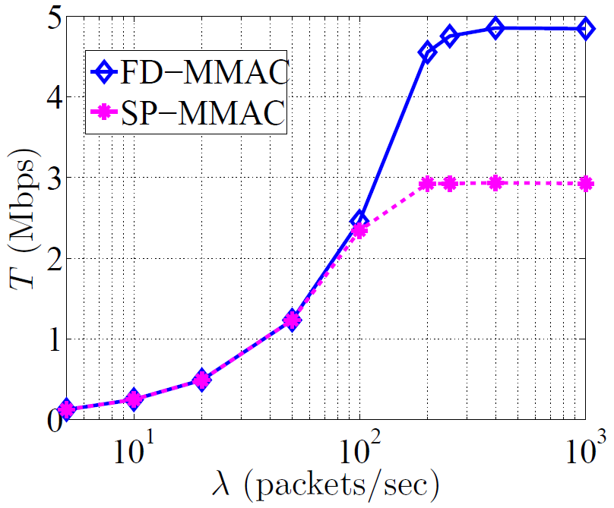
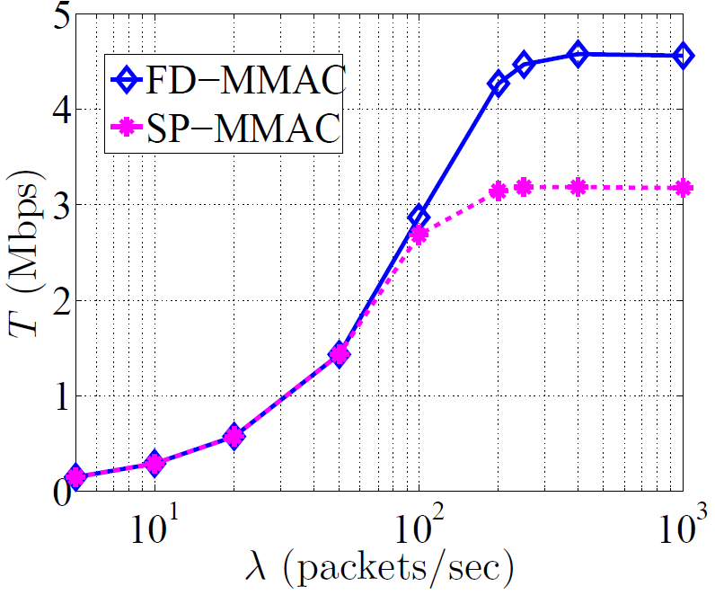
Aggregate Throughput – Exposed/Hidden Terminals
One exposed terminal
One exposed plus one hidden terminal

Slide 22
Final Remarks
Proposed a distributed MMAC protocol that exploits full-duplex
communications
Eliminates the need for a control channel
Coordinates channel access at low control overhead
Combats multi-channel hidden terminal problem
Achieves destination discovery and load balancing autonomously
Improves spatial channel reuse by enabling the operation of
multi-channel exposed terminals

Slide 23
Thank you!

Slide 24
FD Carrier Sensing
MAC for Multi-channel Networks ( MMAC)
Traditional carrier sensing
- Estimate carrier state : free vs. busy
- Defer from transmission if carrier is busy
FD carrier sensing
- Classifies a node’s location relative to an ongoing transmission
into three regions
- Determines the node’s operation state based on region
- Integrates PHY-layer techniques: Error Vector Magnitude (EVM) and Received Signal Strength (RSS) measurements
Advantages of FD carrier sensing
- Eliminates multi-channel hidden terminal problem
- Creates transmission opportunities for exposed terminals
Notes:
Based on the FD communication mode, we proposed a novel FD carrier sensing mechanism, which is the most critical component in FD-MMAC protocol.

Slide 25
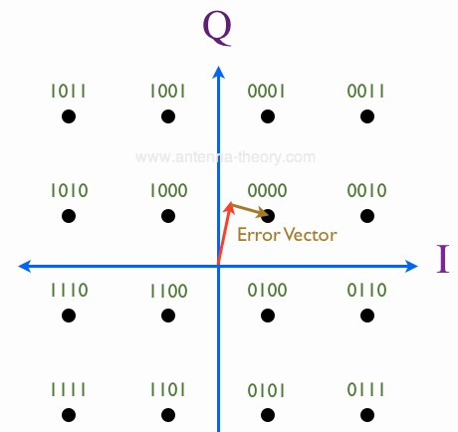
Evaluating Decodability of Data Packet
MAC for Multi-channel Networks ( MMAC)
Problems with traditional decoding method
- C needs to wait until P_{A}’s transmission is completed to verify if P_{A} can
be correctly decoded
C cannot decode P_{A} if it switches to a busy channel in the middle of P_{A}’s
transmission
Solution: C measures EVM values on
received symbols in order to evaluate
decodability of P_{A} before packet reception
- EVM is computed over window size n
Transmitted symbol is unknown to C
for arbitrary data packet
The symbol closest to the received
one is selected as ideal symbol when
computing EVM
Transmitted symbol
Received symbol
Notes:
When a packet is correctly decoded, the received symbols are closest to transmitted ones…(see paper)
EVM measures signal distortion due to interference or impairments on wireless channel, it is strongly related to BER.

Slide 26
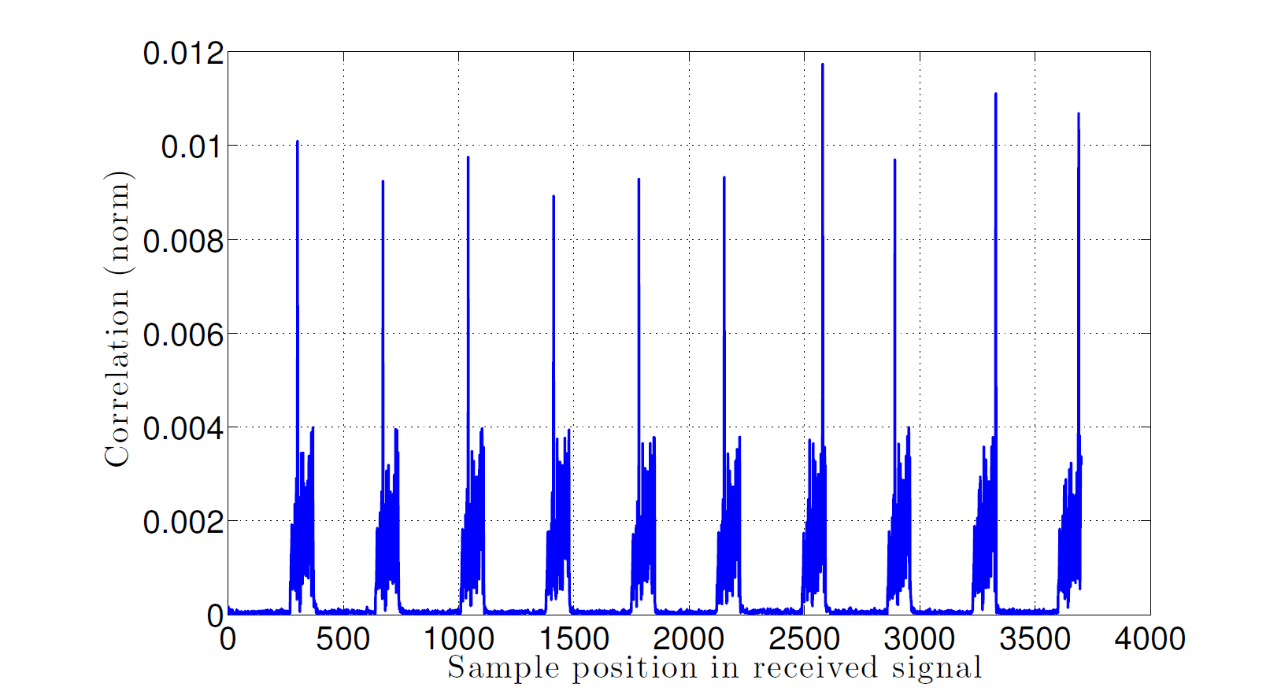
RF Correlation Measurements
MAC for Multi-channel Networks ( MMAC)
BCN_{D}
P_{A}
D
C
A
- Distance_{C-A} = Distance_{C-D} = 7 ft
- P_{A}: 500-bit payload
- BCN_{D}: 50-bit payload
C applies signal correlation
to detect BCN_{D} packets
Detection threshold = 0.005
Normalized correlation for 10 BCN packets
Correlation peaks correspond
to BCN_{D} transmissions

Slide 27
Experimental Evaluation of Region Classification
MAC for Multi-channel Networks ( MMAC)
Experiment setup
USRP devices over the 2.4GHz band
QPSK modulation at a transmission rate of 2Mbps
Applied phase/frequency offset correction and time sync using
88-bit preamble sequence
- Distance_{A-B} = 7 ft
TO
CO
RO
- A and B transmit concurrently
BCNB
- P_{A}: 500-bit payload
C₁
A
B
C₄
- BCN_{B}: 50-bit payload
PA
C₂
- 100 P_{A} and 500 BCN_{B}
transmitted
C₃
EVM, RSS, and decodability of
BCN_{B} are measured

Slide 28
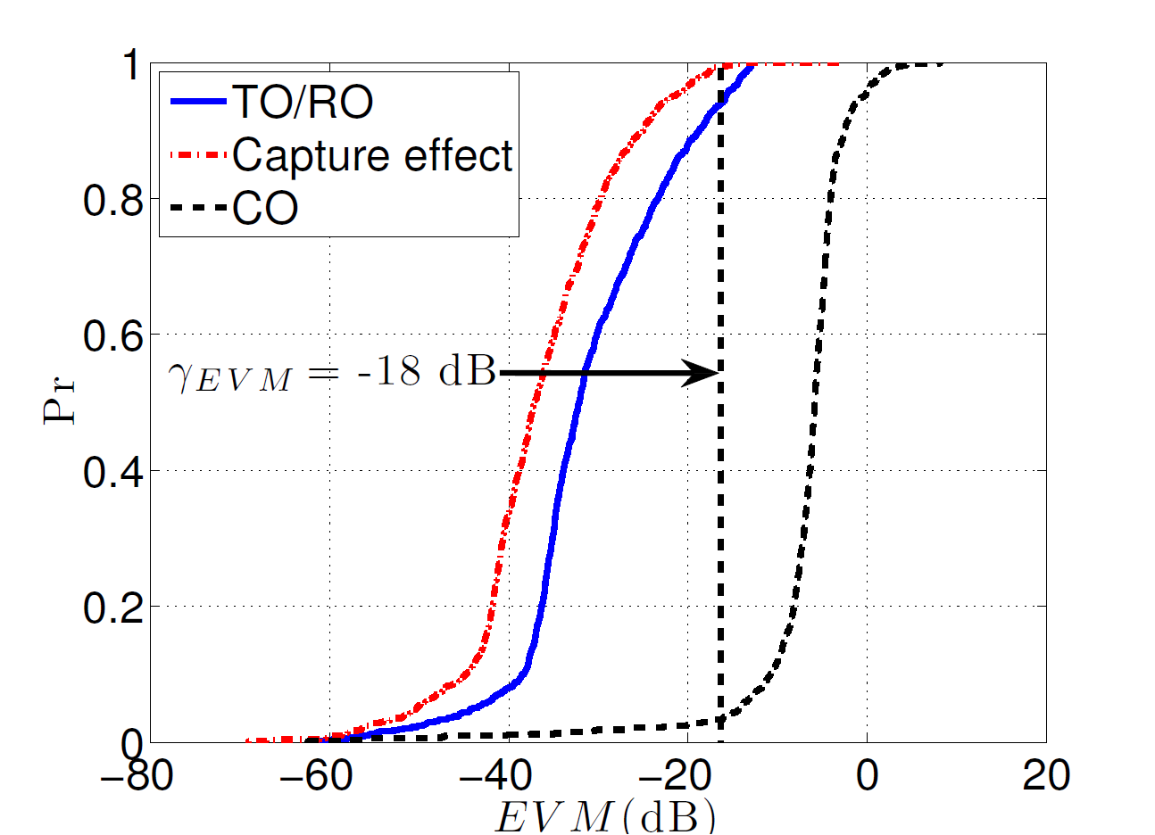
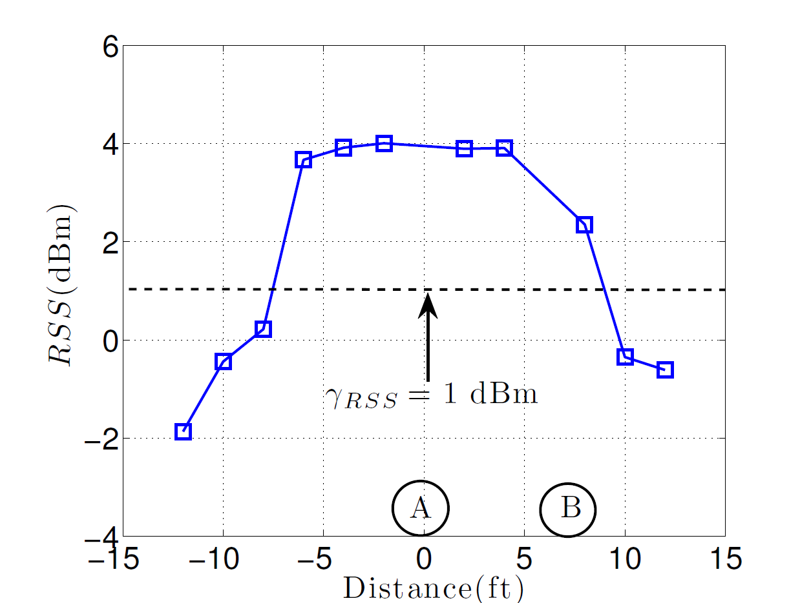
EVM and RSS Mesurements
MAC for Multi-channel Networks ( MMAC)
EVM CDF at RO, CO, and TO regions
Average RSS at different positions

Slide 29
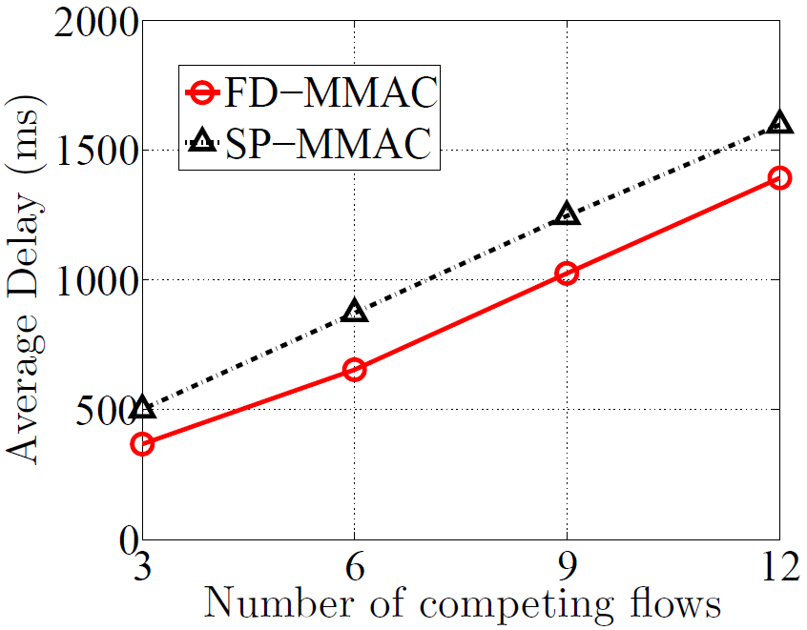
Transmission Delay
Average delay for transmitting a batch of 100 data packets

