Slide 1
Collusion-Resistant Query Anonymization for Location-Based Services
Qin Zhang and Loukas Lazos
qinzhang@emailarizona.edu and llazos@ece.arizona.edu
Electrical and Computer Engineering
University of Arizona
Tucson, Arizona, United States
IEEE International Conference on Communications, 2014

Slide 2


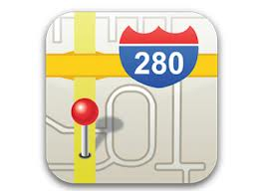



























Location-based Services in Mobile Networks
Maps and Navigation
Transportation
Health Monitoring
Targeted Advertisement
Media (photo, music, video)
Social networking
Gaming
Tourism
. . .
Notes:
An extensive set of heavily used applications today require the disclosure of the user’s location. These so called Location based services include services such as

Slide 3



Service Model
query (with user's location)
Location
based
server (LBS)
LBS
Custom response
based on location
Users may prefer to remain anonymous
Hide sensitive information from untrusted service providers
Query content (information privacy)
Exact user location (location privacy)
Identity (anonymity)

Slide 4
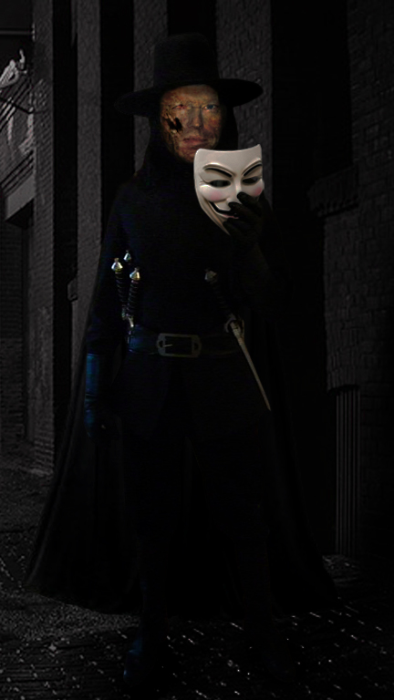

Privacy vs. Access Control
Users
Develop Protocols for Accessing Authenticated Location-Based Services, while preserving Location Privacy and User Anonymity
Service providers

Slide 5
Anonymous Location Services
k-anonymity: a user is indistinguishable from at least (k – 1) other users
Spatial Cloaking: blurring of a user’s exact location into a cloaked region (CR) containing at least (k – 1) other users; Submit several queries at once
a CR achieving 6-anonymity
q_{i} || l_{i} || k
CR with k-anonymity
LAS
LBS
Filtered answers
List of candidate answers
Location Anonymization Server (LAS) may violate the users’ privacy

Slide 6
Decentralized Anonymization
q_{i} || l_{i} || k
CR with k-anonymity
LBS
Agent
List of candidate answers
P2P decentralized schemes: Users form a P2P group for anonymizing their queries
  User location is revealed to peers to compute the CR
  Does not provide user authentication
  Vulnerable to collusion between users and the LBS

Slide 7
Our Contributions – MAZE and L-MAZE
Developed two privacy preserving protocols for authenticated location-based services
MAZE
Does not rely on a third trusted party
Provides k-anonymity
Users are authenticated at the LBS for access control/charging purposes
The protocol is resistant to collusion of peers
Decentralized implementation
L-MAZE
Protocol is resistant to collusion of any (L – 1) peers with the LBS
Preserves other properties of MAZE

Slide 8
The MAZE Protocol
Group Formation Phase
Users form a P2P group of size k
with a desired CR
P2P Group
Query Anonymization Phase
Query Service Phase
User authentication
Query service
Encrypted responses
Anonymized queries
LBS

Slide 9
Group Formation Phase
Culminates to a a P2P group satisfying a privacy profile P_{i} = < k_{i}, φ_{ι} >
k_{i} : anonymity level
φ_{ι} : privacy resolution tolerance
φ_{ι}

Slide 10
Query Anonymization Phase: Basic Building Block
All-or-nothing transformation: A publicly known and completely invertible pre-processing step to a plaintext ([Rivest 1997])
…
y₁
y₂
y₃
y_{k}
query q
F
bijective function
s₁
s₂
s₃
s_{k}
pseudo-messages
No info on q without receiving ALL s_{i} ‘s
Implementations
  Linear AONTs ([Stinson 2001]) – Unconditionally secure
  Package transform ([Rivest 1997]) – Computationally secure
ICC 2010: Alejandro Proano, and Loukas Lazos

Slide 11
Query Anonymization Phase: Step 1
AONT
message
pseudo-messages
query
random key
AONT
query label
AONT
AONT

Slide 12
Query Anonymization Phase: Step 2
Each user distributes the pseudo-messages to the users in set U according to a a random permutation π_{i}(U)

Slide 13



Query Anonymization Phase: Step 3
Each user encrypts all received pseudo-messages with the pairwise key shared with the LBS
+
+
+
g_{id}
+
encrypted pseudo-messages
+
+
+
g_{id}
+
LBS
blurred location
group ID
+
+
+
g_{id}
+
authentication

Slide 14
Query Service Phase: Steps 1,2
Step1: The LBS authenticates and decrypts every message
Step2: The LBS recovers s_{i} using . Applies the inverse AONT F ⁻¹
AONT⁻¹
LBS
AONT⁻¹
AONT⁻¹
g_{id}

Slide 15
Query Service Phase: Steps 3,4,5
Step 3: The LBS prepares response set
Step 4: The LBS sends to all users
r₁
r₁
r₂
r₃
r₂
LBS
r₃
Step 5: u_{i} obtains r_{i} by decrypting with

Slide 16
Query Anonymity Analysis
Query Anonymity at the P2P group – Users cannot reconstruct queries
Query Anonymity at the LBS – The LBS cannot associate a query with a user ID
LBS

Slide 17
LBS + User Collusion
belongs to u₂
AONT⁻¹
LBS
belongs to u₂
We propose the L-MAZE protocol that is resistant to the collusion of up to (L – 1) users with the LBS.

Slide 18
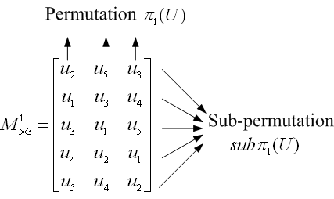
L-MAZE: Query Anonymization Phase: Steps 3, 4
Application of a mixnet: After obtaining k pseudo-messages from the AONT, each user u_{i} generates
Application of onion encryption: A user encrypts each pseudo-message , L times using the sequence of public keys of the set of users denoted by row j of

Slide 19
L-MAZE: Query Anonymization Phase: Steps 5, 6, 7
Every encrypted pseudo-message is broadcast to the entire group U
At each stage, one layer is decrypted
Users wait until they receive (k – 1) pseudo-messages.
Repeat for a total of L stages
u₃ cannot associate s¹_{ID} with u₁

Slide 20
Concluding Remarks
Addressed the problem of location privacy and user anonymity in authenticated location-based services
Developed the MAZE and L-MAZE protocols
Preserve location privacy
Preserve k-anonymity
Provide user authentication
Are decentralized and don’t require trusted parties
Are resistant to collusion
Evaluated the communication and network overhead for different anonymity requirements

Slide 21

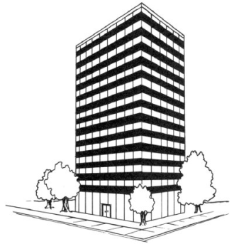
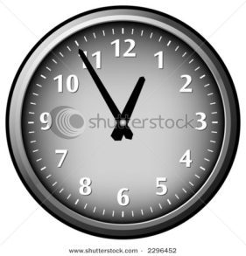
De-identification does not Preserve Privacy
  Location disclosure can lead to an identity disclosure
Restricted-space identification
Time\location correlation
Precise location tracking – Link successive position updates to construct one’s trajectory
User habit profiling
Identity
Residence
+
Activity identification
Time
Company

Slide 22


Adversary Model
CR with k-anonymity
LBS
List of candidate answers
independent
colluding
None of the system participants is trusted (users and LBS)!
Adversary: Curious but Honest
Goals
  Associate a query with a user’s identity or location
  Associate a response with a user’s identity or location
  Learn the contents of a query or response (users only)

Slide 23
Privacy Profile
Every user u_{i} maintains his own privacy profile P_{i} = < k_{i}, φ_{ι} >
k_{i} : anonymity level
φ_{ι} : privacy resolution tolerance
Privacy levels: Ρ = {Pª, P^{b} ,…,P^{g}} satisfy Pª ≥ P^{b} ⇔ kª ≥ k^{b}, φª ≥ φ^{b}
Example:
LOW
MED
HIGH

Slide 24
Group Formation Phase: Step 1
Group initiator (GI) selects k₁ and α ≥ φ₁
GI selects a random point within C(l₁, α)
GI sends group formation message

Slide 25
Group Formation Phase: Step 2
If P₁ ≥ P_{i}, a user u_{j} located within the CR, replies with a join message
All nodes within the CR that receive m_{f}, rebroadcast it

Slide 26
Group Formation Phase: Step 3
If number of joins is less than (k – 1), increase α by expansion factor β
Repeat steps 1, 2
Note:
Users do not respond to requests with the same g_{id}

Slide 27

Location Privacy Analysis
Location Privacy in P2P group
l_{c} is randomly selected
Join reply if within the CR
Location Privacy at the LBS
CR:
User participates only if
CR with k-anonymity

Slide 28
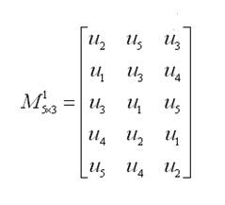
Privacy Analysis of L-MAZE
Query Anonymization under Collusion
L-MAZE is resistant to the collusion of the LBS with up to (L – 1) users.
K Vertices
L – Path
Model
Sub-permutation
Proposition: Each L – path contains at least one non-colluding user
Notes:
Model the mixnet represented by a matrix as a set of paths on a complete graph Gk where the set of vertices corresponds to the users of U.

Slide 29
Privacy Analysis of L-MAZE
Proposition: L-MAZE preserves the query anonymity of the (k – x) non-colluding users when x ≤ (L – 1) users collude with the LBS
The incoming (k – x) encrypted pseudo-messages and (k – x) outgoing ones are uncorrelated
u₁
u₂
Colluder
u₁
u₃
u₄
u₅
Colluder
After first stage, might go to u₁, u₃, or u₄
Traceback, might from u₁, u₃, or u₄
Notes:
Each query will follow a route with at least one non-colluding user on it.

Slide 30
Communication Overhead of MAZE
O_{TOTAL} =O_{gfp} + O_{qap} + O_{qsp}
m_{f} : 1
m_{j} : k – 1 O_{gfp} = k + 1
m_{a} : 1
(k – 1) pseudo-messages MAZE: O_{TOTAL}= 4k + 1
pseudo-messages have 1/k^{th} the size O_{qap}=2k L-MAZE: O_{TOTAL} = (L + 3)k + 1
one message to LBS
L-MAZE: O_{qap} = (L + 1)k
LBS one reply to every query: O_{qsp} = k

Slide 31
Network Overhead of MAZE
Account for the messages that need to be relayed
Infrastructure-based Networks
Two network messages per group message
MAZE: O_{TOTAL} = 2(4k + 1)
L-MAZE: O_{TOTAL}= 2(L + 3)k + 2
Ad hoc Networks
Network overhead is topology-dependent
Assumptions:
Users are uniformly distributed within the network area with a density d
LBS can be reached via single transmission
All users have the same privacy level
Group messages are relayed via a broadcast routing tree

Slide 32
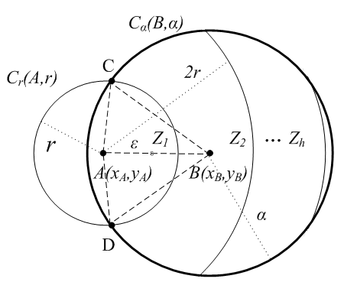
Estimated Network Overhead of MAZE
Group Formation Phase:
Step1: All nodes within the CR relay m_{f}: d π α²
Step2: Users i hops away need i messages to reach GI
Maximum hop distance
AB = ε may vary from 0 to α
Pr[AB ≤ ε ] = ε/α, 0 ≤ ε ≤ α
Average all possible value of ε:

Slide 33
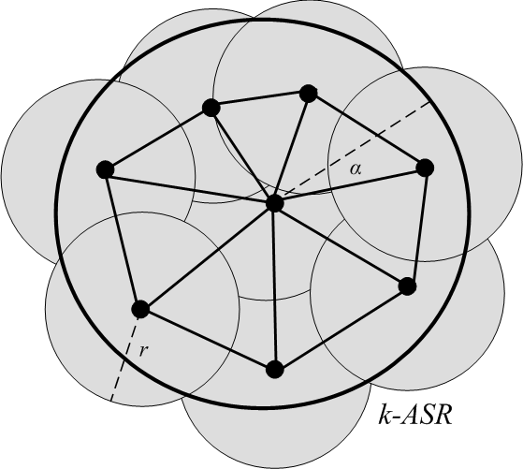
Estimated Network Overhead of MAZE
Step3: GI sends m_{a} to all (k – 1) users via a broadcast tree
We approximate this by a connected network of users that cover CR
For coverage [Liu and Towsley 2004]:
For connectivity [Xing et al. 2005]: set r₀ = r/2
# of network messages for broadcasting:

Slide 34
Estimated Network Overhead of MAZE
Query Anonymization Phase
Users exchange pseudo-messages through the broadcast tree
For L-MAZE

Slide 35
Experimental Setup
Main parameters | Default Values
Size of Area | 1,000m x 1,000m
User Density | 0.0005
User communication range | 250m
Number of topologies | 40
Anonymity level k | 10
CR expansion parameter β | 0.1
Assumptions:
Users are uniformly distributed
Users form a multi-hop ad hoc network
The group communicates using a broadcast routing tree
By default, assume all users have same privacy level.

Slide 36
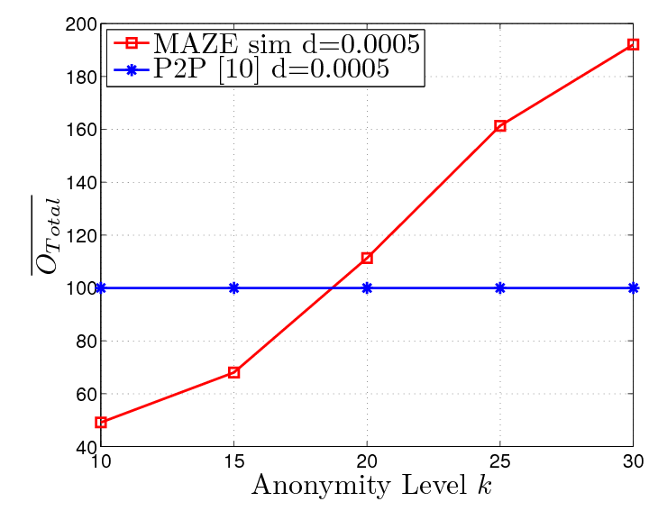
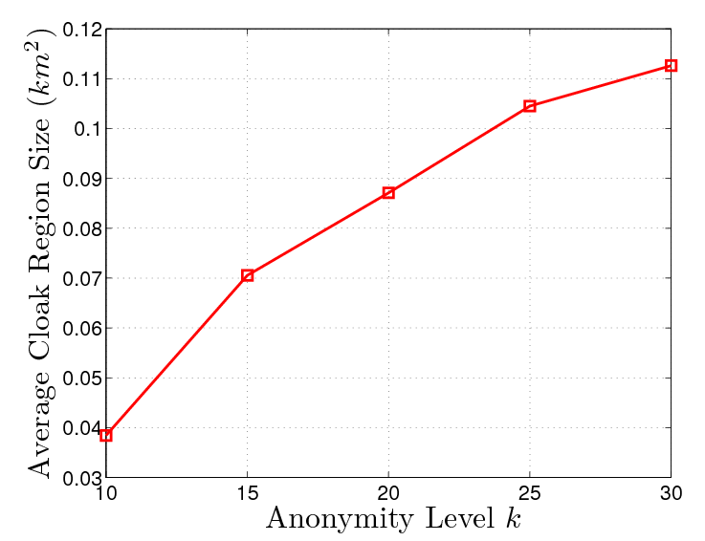
Impact of the Anonymity Level k
The cloaking region size is varied according to the anonymity level k
Initial value:
Increased by a factor β, if k users were not discovered

Slide 37
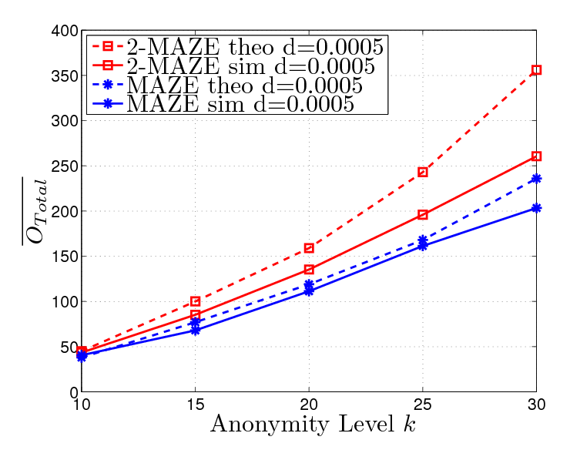
Comparison between MAZE and 2-MAZE
Error accumulation with the increase of k

Slide 38
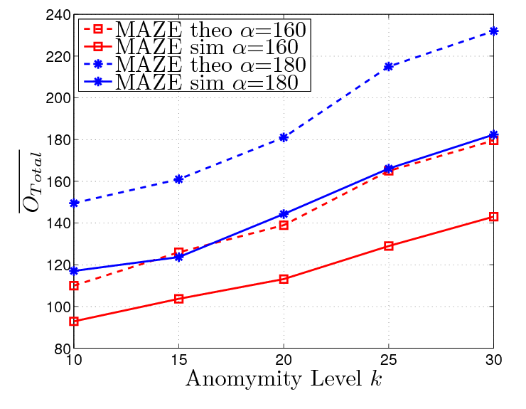
Fixed Cloaking Region
α is set to be a fixed value, independent of the anonymity level k.

Slide 39
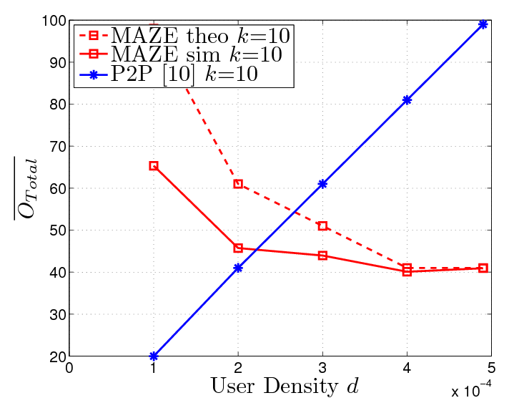
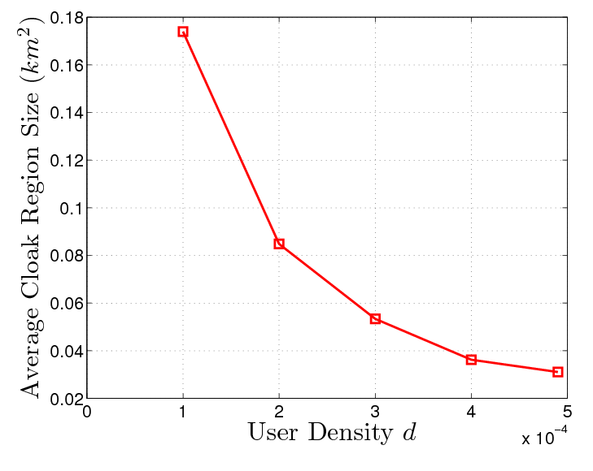
Impact of User Density
P2P: The number of users within one-hop of the GI is a linear function of d
MAZE: with high density, all within one hop. Smaller CR is needed, approach to a asymptotic value.

Slide 40
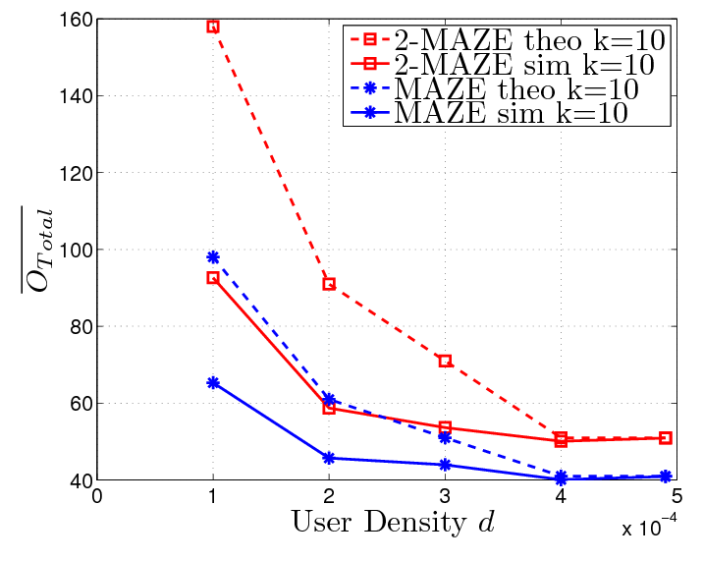
Comparison between MAZE and 2-MAZE

Slide 41
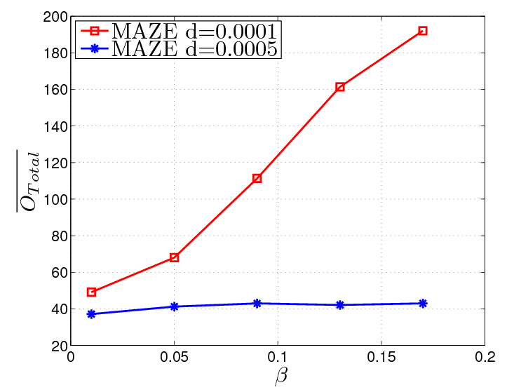
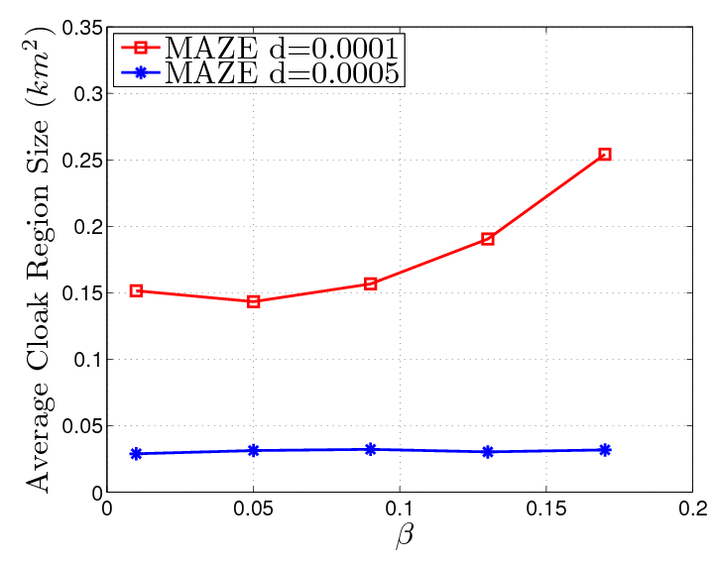
Impact of the k-ASR Expansion Factor β
The smaller β is, the more accurate k-ASR is.
The bigger β is, the faster a k-ASR can be found, but more users are involved, thus higher overhead .

Slide 42
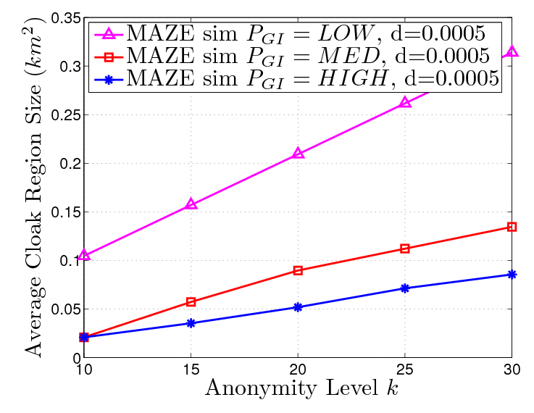
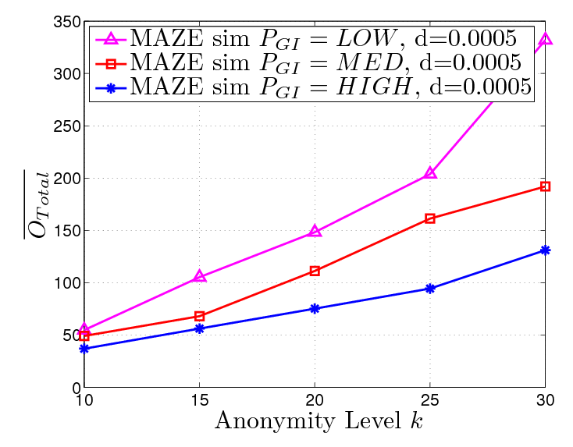
Impact of GI’s Privacy Requirement
Users’ privacy was set to one of three privacy levels:{LOW, MED, HIGH} at random
When GI’s privacy level is LOW, higher overhead and larger CR are needed

