Slide 1
Security Vulnerability and Countermeasures of Frequency Offset Correction in 802.11a Systems
Hanif Rahbari, Marwan Krunz, and Loukas Lazos
Department of Electrical & Computer Engineering
University of Arizona
INFOCOM 2014

Slide 2
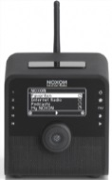
Jamming Wireless Communications
Jamming: intentional interference with radio transmissions
hdr
payload
Alice
Bob
Jay
Jamming models: constant, random, reactive, frame-selective
Models differ in hardware, energy requirements, complexity, stealthiness, effectiveness

Slide 3
Jamming Efficiency - Duration
Jamming duration (τ_{j}) for dropping a packet
A function of coding, data rate (modulation), interleaving, jamming power, …
τ_{j}
hdr
payload
τ_{j}: 10% - 20% of a frame, BER ~ 5% - 10%
τ_{j}
τ_{j}: 0.5% of the frame, BER ~ 50%
Frequency Offset (FO) attack
Targets the part of the preamble used for FO estimation
Independent of coding scheme, data rate, etc.

Slide 4
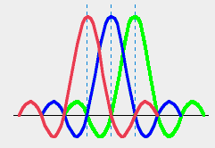
Frequency Offset (FO) in OFDM Systems
Frequency Offset (FO): The difference in operating freq. between two devices
OFDM systems (802.11a/g/n, …) are very sensitive to FO
FO
Non-zero ICI
Zero ICI
Frequency domain: OFDM subcarriers w/o FO
Frequency domain: OFDM subcarriers w/ FO

Slide 5
802.11a Preamble
FO is estimated from the PHY preamble (publicly known)
Subcarrier spacing of STSs and LTSs
Δf_{l} = Δf
Δf_{s} = 4 Δf
f
f
1
5
9
f
1
2
3
STS Spacing
LTS Spacing
Related to the FO amount that can be corrected
Notes:
Only jam STSs

Slide 6
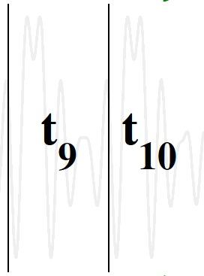
FO Estimation (Noiseless)
t
r_{i+t}
r_{i}
i^{th} sample
Phase offset
r_{i}
r_{i+t}
Same sample
transmitted after t
conjugate
FO
r_{i+t}
r_{i}
*

Slide 7
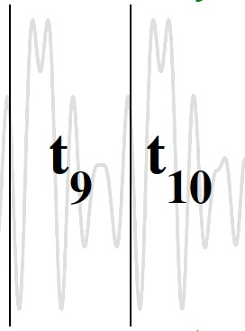
FO Estimation (Noisy)
Because of noise, the estimation is erroneous
: an estimate of in the presence of noise
To better estimate , a summation of ’s is used
t

Slide 8
FO Estimation Limits
Estimated phase offset is limited to
Estimated FO:
FO is unambiguous as long as δf ≤ 0.5 * subcarrier spacing
STS can correct up to 2Δf LTS can correct up to 0.5Δf
Rx first uses STSs for coarse FO estimation (less samples)
LTS are used for FO estimation refinement (more samples)
Δf_{l} = Δf
Δf_{s} = 4 Δf
f
f
1
5
9
f
1
2
3
STS Spacing
LTS Spacing

Slide 9
FO Estimation and Correction (Example)
An OFDM system with 4 subcarriers
1) Estimate using STSs
2) Estimate using LTSs
1
2
Receiving
Correct after STSs
Correct after LTSs
Alice
Bob
Notes:
Assume Alice transmits exactly at the nominal frequency.
During STSs, only one subcarrier is active

Slide 10
FO Estimation Attack
Principle: Alter the estimated FO beyond the correctable range of LTSs by jamming STSs
Phase differences as seen during STSs:
Correctable phase offset range by LTSs
Jamming is successful if
To correct FO after STSs
Notes:
Delude Bob into incorrectly estimating the FO during STSs such that the resulting correction after STSs is not fixable during LTSs.

Slide 11
FO Estimation Attack (Example)
Alice
10
11
00
Receiving
Correct (STSs)
Correct (LTSs)
xx
00
00110110
01
11
Bob
01
Channel estimation errors due to large FO during LTSs
00 11 01 10 →
xx 00 11 01 →
xx xx xx xx → ~0.5 BER
Notes:
Correct FO = 40%

Slide 12
Step 1: Impose a Desired Phase Offset
Use a jamming signal u with the same structure as STSs
For STS + jamming samples:
(2)
known phase
(1)
(2)
(3)
(1) scalar
(3) Unknown amplitude
& unknown phase
Eve-Bob FO
Notes:
Δ𝜑_𝐸: Eve to Bob phase offset
Υ : a complex coefficient
Besides the actual FO between Eve and Bob, Eve can add an artificial FO to the jamming signal to create a total FO of Δ𝜑_𝐸 at Bob
Assume that Eve precisely detects the beginning of the frame.
\delta f_ab is known
Eve is unable to control ∠𝑩 because 𝑟 and 𝑢 are channel dependent and hence, unknown
I.e., the last two terms in 𝑩 are unknown

Slide 13
Step 1: Impose a Desired Phase Offset (con’d)
To control , the jammer first has to eliminate the effect of the channel-dependent term urY
Rearrange

Slide 14
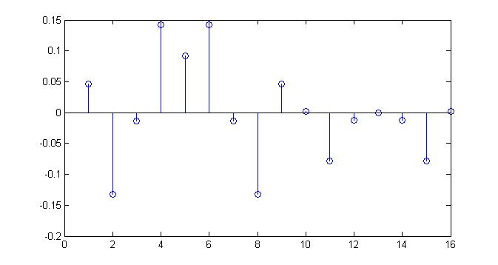
Step 2: Elimination of Channel-Dependent Term
Define the second jamming sample u₂ as a function of the first sample u₁ to eliminate the effect of urY (pairing rule).
Preamble samples at the Tx

Slide 15
Step 3: Selection of Injected Offset
B is simplified to one scalar and one complex variable with controllable phase
Multiply samples of u_{i} with any desired phase to inject desired offset at the Rx
For sample i of u_{i} -> Multiply with
is the additional FO to ensure obtains any desired value
Additional optimizations w.r.t. jamming power |u_{i}|²

Slide 16
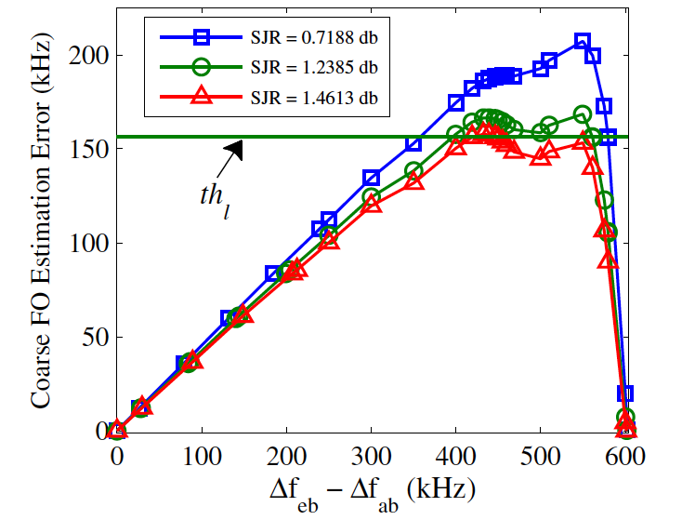
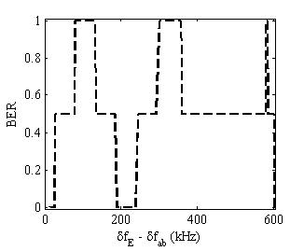
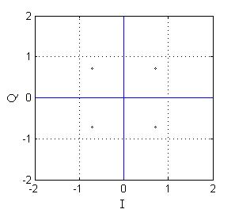
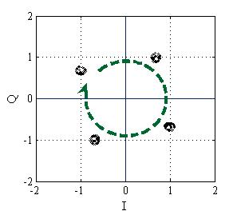
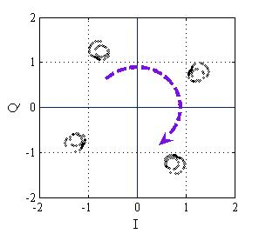
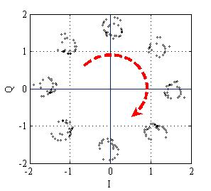
Evaluation (Simulations)
Estimated by STSs
BER after LTSs
Demodulated into wrong bits but possibly correctable
Worst case:
Demodulated into wrong subcarriers: random bits
Correct bits (no demodulation error)
Corresponding constellation maps of data symbols
Notes:
Rotation because of channel estimation errors
Implemented in LabVIEW
Parameters
1) 𝛿𝑓_𝐸: Eve’s FO
2) Signal-to-Jamming ratio
Metrics:
1) Coarse FO estimation error
2) Channel estimation MSE
3) BER
Assumptions
AWGN channel
Accurate frame detection

Slide 17
Final Remarks
We have demonstrated fast frame detection and accounted for timing imperfections: https://www.youtube.com/watch?v=WAumaL0YOJE
We have optimized the attack w.r.t jamming power
Demonstrated the FO attack on USRPs
Preliminary Defenses
Sequence hopping (SH)
To estimate this FO, nonadjacent sequences (up to two STSs away) are sufficient
Randomly select two STSs from all the STSs
Preamble obfuscation: modify the preamble structure at the Tx
Example: Tx artificially changes the FO of the preamble according to some pre-agreed rule, not known to the jammer
1
2
3
4
5
6
7
8
9
10

Slide 18
Frame Detection (Symbol Timing)
1st window
2nd window

Slide 19
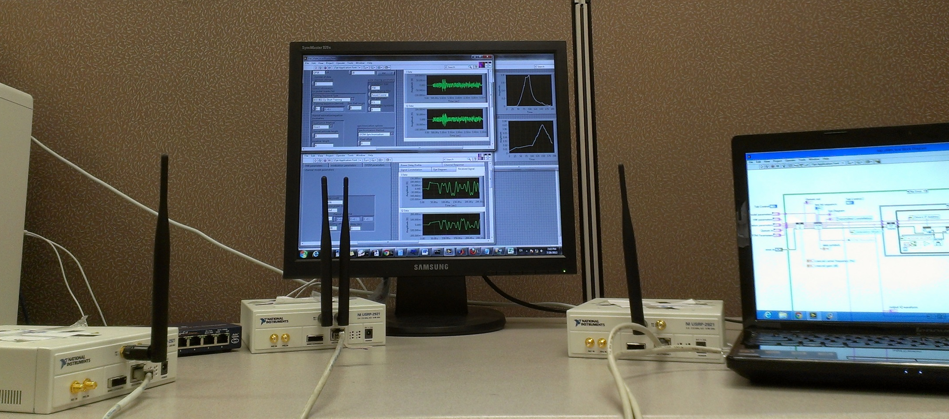
Experimental Evaluation
NI-2921 USRPs
5GHz band
Connection through Gigabit Ethernet NIC
Alice
Bob
Eve

Slide 20
Step 3: Optimizing the Jamming Power
Eve to Bob FO
Successful attack
region

Slide 21
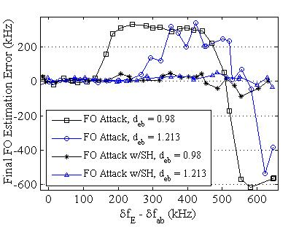
Experimental Evaluation (con’d)
Estimated FO after LTSs
d_{eb}: Eve-to-Bob to Alice-to-Bob distance ratio (equivalent to SJR)
Sequence Hopping (SH) is often successful in mitigating the FO attack
The jammer is successful even if he has a longer distance to the RX
Successful attack: One shift forward
Successful attack: Two shifts backward
Notes:
A USRP is not capable to switch from Rx to Tx fast enough
Our remedy: Detect a packet, jam the next one
Alice transmits at fixed intervals of 𝑇 milliseconds
Eve need to react in less than 4 microseconds once she detects a frame
The best reaction time of USRPs is shown to be 15 microseconds

Slide 22
Step 4: Accounting for Synchronization Errors
Jamming seed
1
2
3
5
9
4
6
7
10
11
13
8
12
14
15
16
Notes:
Blue edges (dependencies) are due to pairing rule while green edges are due to chaining rule

