Slide 1

Thwarting Inside Jamming Attacks on Wireless Broadcast Communications
Sisi Liu, Loukas Lazos, and Marwan Krunz
Dept. of Electrical and Computer Engineering
University of Arizona
WiSec 2011, Hamburg, Germany

Slide 2
Roadmap
Jamming of broadcast communications
Time delayed broadcast scheme (TDBS) – single hop topologies
Time delayed broadcast scheme – multi-hop topologies
Security and performance evaluation
Final Remarks

Slide 3
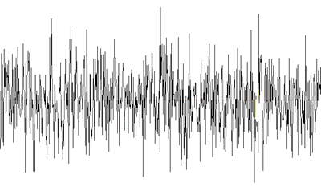
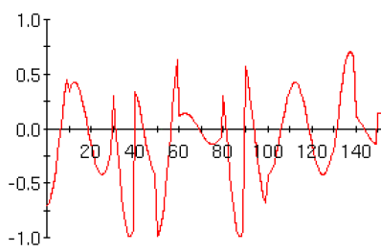
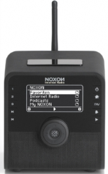
Jamming of the Wireless Medium
Open nature of wireless medium leaves it exposed to Jamming
Jamming: Deliberate interference with radio transmissions in order to decrease SNR and corrupt signal beyond recovery
Sender
Receiver
Jamming

Slide 4
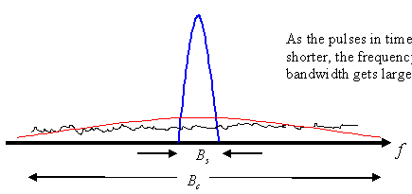
Conventional Anti-Jamming Techniques
Spread-spectrum (SS) communications
Adversary has to spread his energy on a large bandwidth
PN_{i}
PN_{i}
f₄
l₂
f₃
l₁
f₂
l₄
f₁
slot 1
slot 2
slot 3
slot m
l_{i}: location of transmission at slot i
Notes:
Unfortunately, spread spectrum communications can provide anti-jamming protection only to the extent that the PN sequence remains secret.

Slide 5
Extending SS to Broadcast Communications
PN_{i}
PN_{i}
PN_{i}
PN_{i}
PN_{i}
PN_{i}
PN_{i}
PN_{i}

Slide 6


Broadcast Communications in Wireless Networks
Impact of Broadcast Jamming on Wireless Networks
Omni-directional antennas – Broadcast advantage
  A single transmission can reach multiple receivers
  Energy and bandwidth efficient
  Extensively used to disseminate control information
s
infrastructure-based: Cell broadcasting, paging, synchronization
ad-hoc: bootstrapping, channel access, routing

Slide 7
Problem Statement - Contributions
Problem:
Develop anti-jamming methods for broadcast communications
Internal threat model – compromise of network devices
Contributions:
Propose a frequency hopping (FH) technique for broadcasting
Map the FH design to 1-factorization problem in complete graphs
Show resilience to jamming under node compromise
Eliminate common secrets such as PN codes, keys, etc.

Slide 8
Relevant Work – Internal Jammer Model
Uncoordinated Frequency Hopping (UFH) [Pöpper et al, JSAC 2010]
Uncoordinated Direct-Sequence SS [Pöpper et al, Usenix 2009]
Randomized Differential DSSS [Liu et al, Infocom 2010]
Tree-based keying schemes for identifying inside jammers [Chiang and Yu, Infocom 2008]

Slide 9
Time-Delayed Broadcast Scheme (TDBS)
n₂
A series of unicast transmissions
spread over frequency and time
n₃
n₄
n₁
x
n₅
f₁
f₂
n₁
n₂
f₃
n₁
n₃
n₁
n₅
f₄
n₁
n₄
n₁
n₅
Time slot: 1 2 3 4 5

Slide 10
TDBS – Design Motivation
  Concurrent unicasts on multiple frequencies
  Jammer can only block a fraction of the transmissions
Trade delay and energy efficiency for jamming resilience
Differences with classical FHSS systems
  Each node is assigned a unique PN sequence
  Compromise of a subset of PN sequences limits the information leakage with respect to uncompromised ones
Other design aspects
  Fairness, delay minimization
How to design hopping sequences?
Notes:
And the location of the unicast as we showed in the last page is defined by a frequency/slot pairs

Slide 11
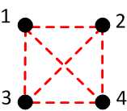
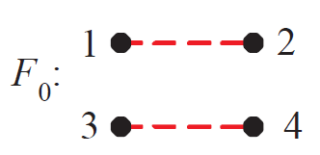
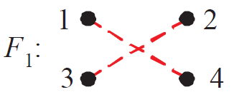
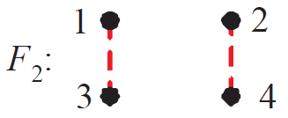
Some Definitions
Definitions
  Complete graph K_{2n}(V, E): each pair of vertices in V is connected by an edge
  1-factor F: a set of pairwise-disjoint edges that cover V (matching)
  1-factorization F_{2n}: A series of (2n - 1) factors F_{2n} = {F₀, F₁ ,…, F_{2n-2}} that span the edge set E
  Theorem: Complete graphs are 1-factorable
1-factor
K₄
1-factorization

Slide 12
Mapping to the 1-factorization Problem
For each 1-factor, randomly assign frequency bands to each pair
communicating pair
set of nodes in broadcast group
f₂
f₂
f₂
f₃
f₃
f₃
f₄
f₄
f₃
f₁
f₅
f₁
f₅
f₅
f₃
f₃
f₅
2
Slot:
h₁:
h₂:
h₃:
h₄:
f₃ . . .
f₁ . . .
f₃ . . .
f₁ . . .
1
1 2 3 4 5
F₀:
f₃
3
4
1
f₃
2
F₁:
3
f₄
4
1
2
F₂:
f₁
f₅
3
4

Slide 13
TDBS – SU: Sequential Unicast Mode
n₂
Sender sequentially relays information
to intended receivers
Applicable to infrastructure-based nets
n₃
n₄
n₁
n₅
f₁
f₂
n₁
n₂
f₃
n₁
n₃
K: number of channels
2n: number of nodes
f₄
n₁
n₄
n₁
n₅
Time slot: 1 2 3 4

Slide 14
Properties of the SU mode
1-factorizations guarantee that every node will meet every other node in (2n - 1) slots
Compromise of a node reveals the rendezvous of that node
F₀ | F₁ | F₂ | F₃ | F₄ | F₅ | F₆ | F₀ | F₁ | F₂
1 8 | 1 2 | 1 3 | 1 4 | 1 5 | 1 6 | 1 7 | 1 8 | 1 2 | 1 3
2 7 | 3 8 | 4 2 | 5 3 | 6 4 | 7 5 | 8 6 | 2 7 | 3 8 | 4 2
3 6 | 4 7 | 5 8 | 6 2 | 7 3 | 8 4 | 2 5 | 3 6 | 4 7 | 5 8
4 5 | 5 6 | 6 7 | 7 8 | 8 2 | 2 3 | 3 4 | 4 5 | 5 6 | 6 7
Slot: 1 2 3 4 5 6 7 8 9 10

Slide 15
TDBS–AB: Assisted Broadcast Mode
Any node that receives a broadcast message acts as a broadcast relay
Applicable to ad hoc based nets
n₂
n₃
n₄
n₁
n₅
f₁
f₂
n₁
n₂
n₂
n₄
f₃
n₁
n₃
K: number of channels
2n: number of nodes
f₄
n₃
n₅
Time slot: 1 2 3

Slide 16
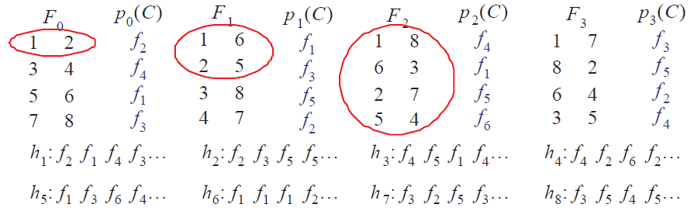
Constructing FH Sequences for the AB Mode
Relay set of node j: set of nodes that can relay a transmission originating from j
Goal: Maximize for every j and every 1-factor

Slide 17
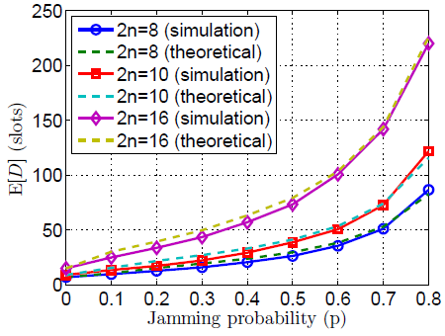
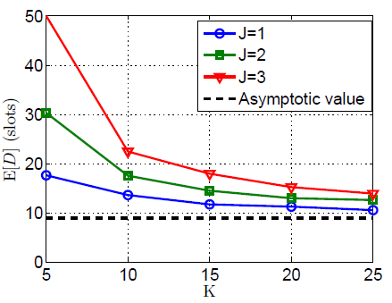
Resilience to External Jammers – SU Mode
Random Jammer
  E[D]: Expected delay for the completion of a broadcast
  p: J/K fraction of channels jammed by adversary

Slide 18
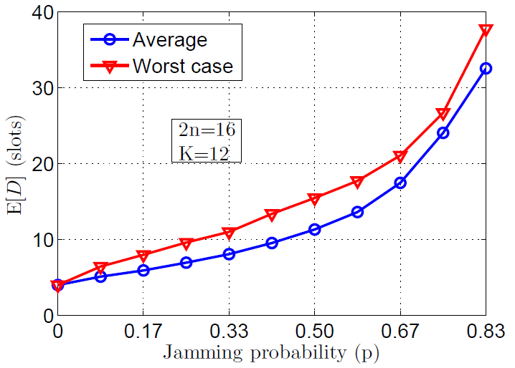
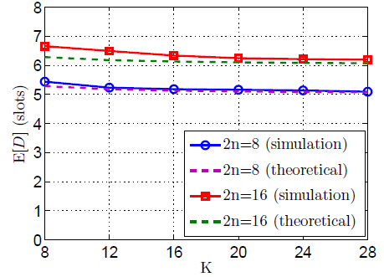
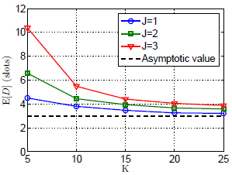
Resilience to External Jammers – AB Mode

Slide 19
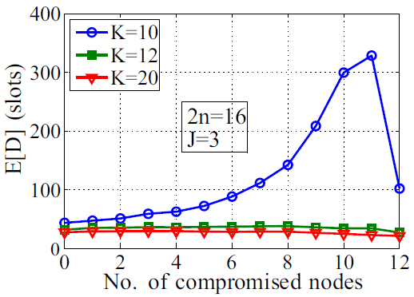
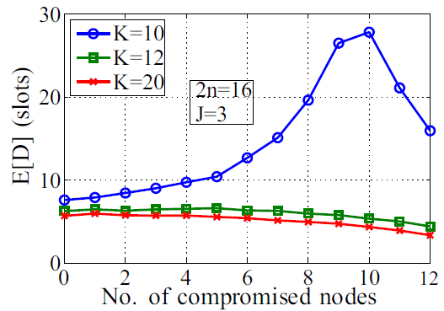

Resilience Under Node Compromise
Jammer has compromised $r$ nodes (FH sequences become known)
Uncertainty with respect to the FH sequences of legitimate nodes is reduced
E[D] until legitimate nodes receive a broadcast message
SU mode
AB mode

Slide 20




Extension to Multi-Hop Networks
Cluster-based network architecture: Clique clustering
Intra-cluster slots
Inter-cluster slots
$$⋯$$
$$⋯$$
Interleave
$$⋯$$
$$⋯$$

Slide 21
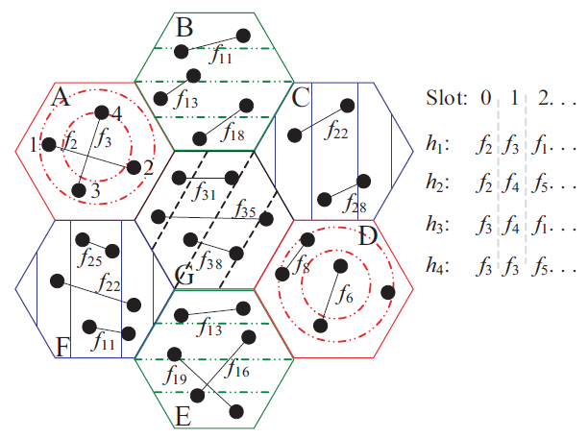
Intra-cluster phase
Divide set of frequencies to 4 sets
Apply 4-color theorem
Construct FH sequences for the nodes within each cluster (AB or SU mode)

Slide 22
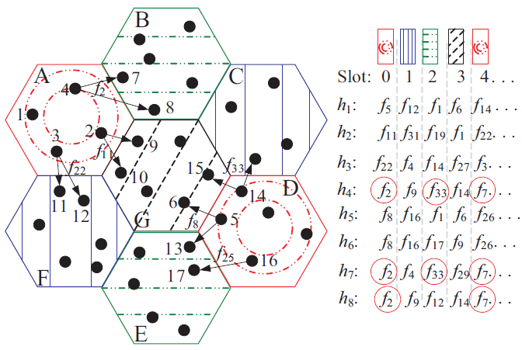
Inter-cluster phase
Cluster labeling: Clusters with same color transmit on the same slot
Create bipartite graphs between gateway nodes (break ties, merge)
Assign random permutation of frequencies to edges
f₂
4
7,8
f₁₁
2
9,10
cluster A
18
f₂₂
3
11, 12
f₃₃
14
15,18
f₈
5
6,13
cluster D
f₂₅
16
17

Slide 23
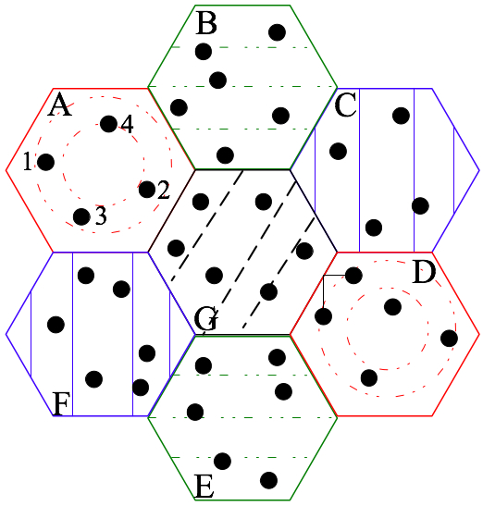
Evaluation of Multi-hop Scenario
Security metrics
N_{c} : # of adjacent clusters on average
N_{L} :# of “bridge links” between two adjacent clusters
E[D_{f}]
E[D_{e}]
E[DIV]

Slide 24
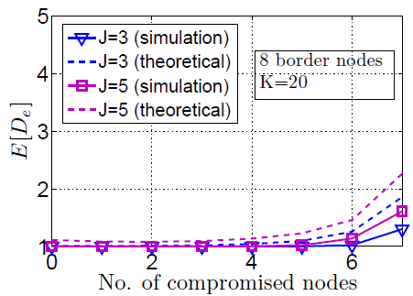
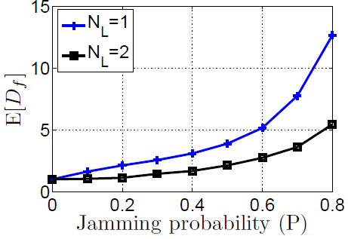
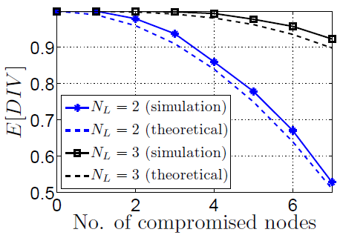
Evaluation of Multi-hop Broadcasting

Slide 25
Final Remarks
Developed Time-delayed Broadcast Scheme
  Anti-jamming scheme for broadcast communications under internal threat model
  Trades delay and communication efficiency with jamming resilience
  Realizes broadcast as a series of unicasts distributed in frequency and time
  Uses a mapping to 1-factorization of complete graphs to improve resilience while reducing delay
Future TDBS features
  Dynamic addition and deletion of broadcast group members
  Investigation of FH adjustment for collision avoidance among neighboring clusters
  FH resynchronization in case of synchronization loss

