Slide 1
Network Anomaly Detection Using Autonomous System Flow Aggregates
Thienne Johnson^{1,2} and Loukas Lazos¹ ¹Department of Electrical and Computer Engineering
²Department of Computer Science
University of Arizona
IEEE GLOBECOM 2014 December 10, 2014

Slide 2
Network Anomalies

Slide 3
Characteristics of Network Anomalies
Examples
Anomaly | Characteristics | Variations in
DDoS | (D) DoS against a single victim | Number of packets and number of flows
Alpha | Unusually high rate point to point byte transfer | Number of packets and volume
Scan | Scanning a host for a vulnerable port (port scan) Scanning the network for a target port (network scan) | Incoming flows to a host:port Incoming flows to a port number

Slide 4
Anomaly detection
Deep packet inspection
scalability problem in terms of computational
and storage capacity
Flow aggregation techniques
merge multiple flow records with similar properties, and discarding benign flows
summarize IP flows to statistical metrics
reduce the amount of state and history information that is maintained
At IP flow level: computation and storage requirements for an online NIDS can still be prohibitively large

Slide 5
Our Goals
To reduce communication and storage overheads
By exploiting the organization of the IP space to Autonomous Systems (ASes)
To detect large-scale network threats that create substantial deviations in network activity compared with benign network conditions

Slide 6
Outline
System design
Case Study
Conclusion and future work

Slide 7
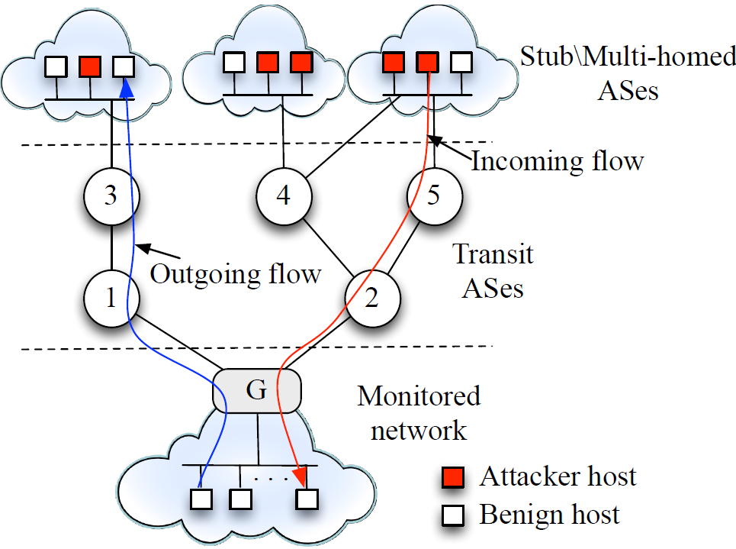
AS level anomalies at a monitored network

Slide 8
Methodology
2
3
4
1
5

Slide 9
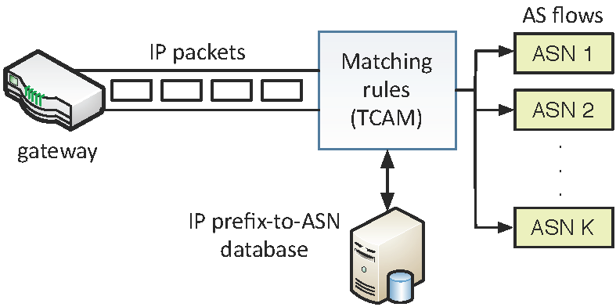
– IP-to-AS Flow Translation
1
Each AS flow:
Number of IP flows
Number of IP packets
Volume (Bytes)
Aggregate IP flows
to AS flows

Slide 10
– Metrics for data aggregation
2
Different anomalies affect different network flow parameters
During aggregation period A:
1. Packet count (N): number of packets associated with the AS flow
2. Traffic volume (V): traffic volume associated with the AS flow
3. IP Flow count (IP): number of IP flows associated with the AS flow
4. AS Flow count (F): The number of AS flows that are active
.Flows from spoofed IP addresses (network/16) are aggregated as a flow from Fake AS nodes
.Flows from ASes not contacted before could be an anomalous event

Slide 11
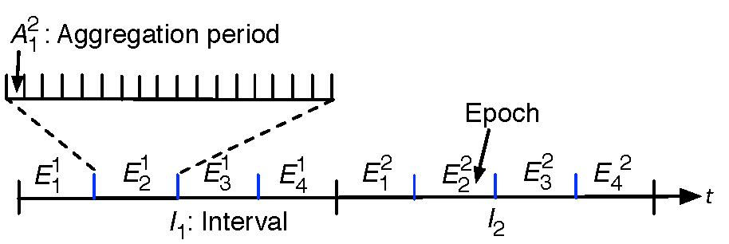
– Data aggregation
2b
Training Phase: intervals I₁,...,I_{m}.
Traffic for each of the m intervals is represented by the same model.
Online Phase: traffic model for the online phase is computed over an epoch, which is shorter than an interval.
Collect k samples for each metric using the aggregate values over k aggregation periods

Slide 12
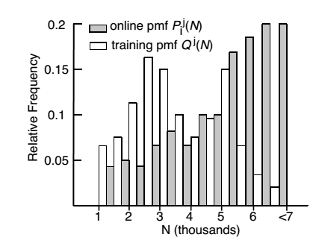
3
– Statistical Analysis
For every AS flow, and every metric:

Slide 13
3b
– Statistical Analysis
Real-time
data
Measure statistical divergence
X
D
Training data
pmf
Jeffrey distance
$$Λ\left(P,Q\right)=\frac{1}{2}(KL\left(P,Q\right)+KL\left(Q,P\right))$$
where (KL(P,Q) if the Kullback-Liebler divergence
$$KL\left(P,Q \right)=\sum_{i=1}^{k}{p_{i}×log⁡\left(\frac{p_{i}}{q_{i}}\right)}$$

Slide 14
– Statistical Analysis
3c
Distances are normalized to ensure equal distance scales when multiple metrics are combined to one
$$J\left(P_{i,j}\left(M\right),Q_{j} (M)\right)=\frac{Λ\left(P_{i,j}\left(M\right),Q_{j} (M)\right)}{{Λ\left(P_{i,j}\left(M\right),Q_{j} (M)\right)}_{95th}}$$
Value that fall in the 95th percentile of historical distance for metric i accumulated over moving window W

Slide 15
4
– Composite Metrics
To capture the multi-dimensional nature of network behaviors, composite metrics combine several basic metrics
$$C_{i}=G_{i}\left(J\left(N\right),J\left(V\right),J\left(IP\right),J\left(F\right)\right)$$
weighting formula among the different metrics
Weights could be adjusted to favor a subset of metrics, depending on the nature of the anomaly to be detected.
Foreach Epoch
Ci > Threshold?
Alert abnormal behavior

Slide 16
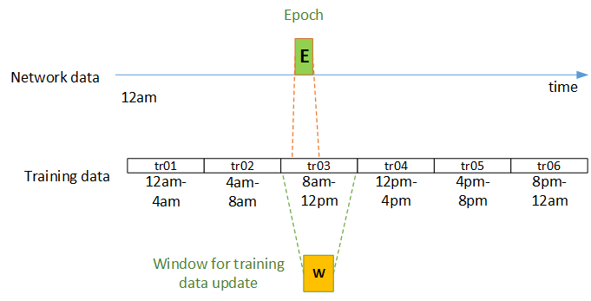
- Training data update
5
Moving window mechanism for maintaining the training data
D(E,W) < Threshold
Update

Slide 17
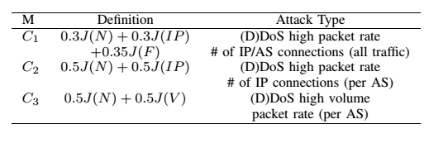
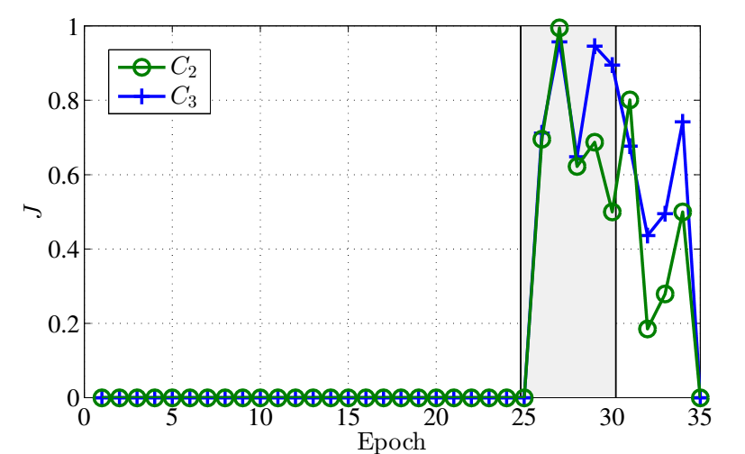
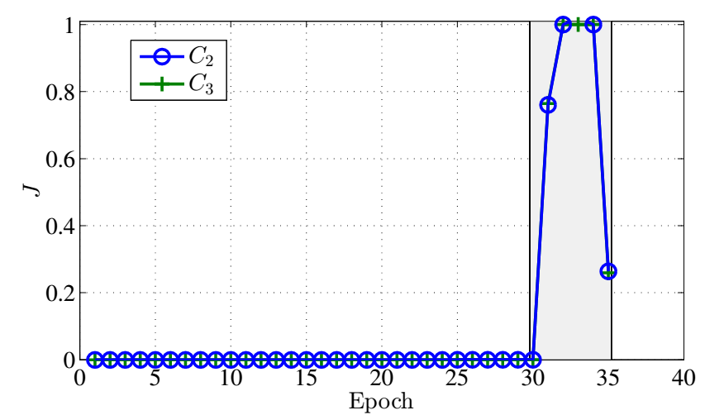
Case study
MIT LLS DDOS 1.0 intrusion dataset which simulates several DoS attacks and background traffic.
Anomaly in AS A
Anomaly in AS B

Slide 18
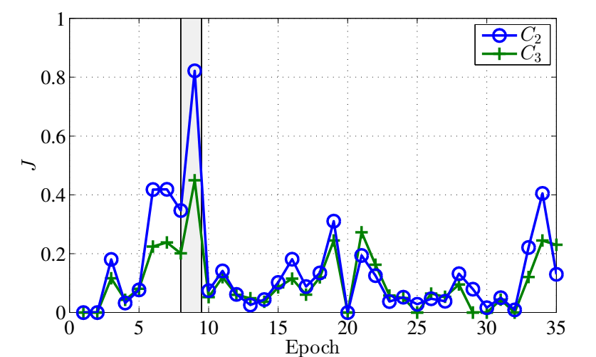
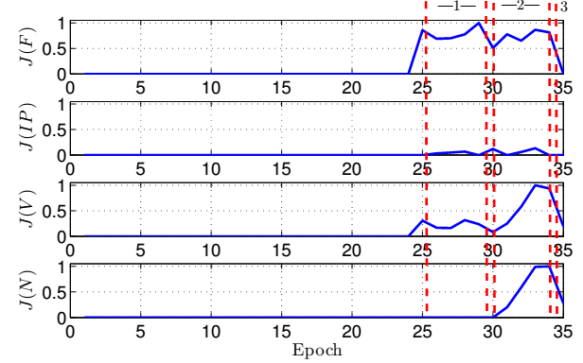
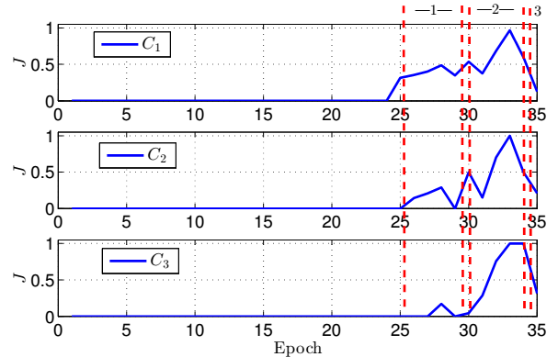
Anomaly in AS C
Volumetric analysis – no AS distinction

Slide 19
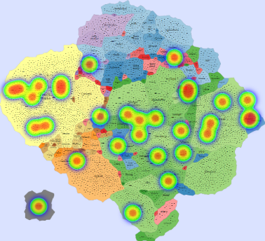
Example of use with IMap
Anomaly scores per AS
Fowler, J; Johnson, T; Simonetto,P; Lazos, P; Kobourov, S.; Schneider, M. and Acedo, C. IMap: Visualizing Network Activity over Internet Maps, Vizsec 2014.

Slide 20
Conclusions & Future work
NIDS based on AS flow aggregates.
Reduction in storage and computation overhead
Basic network anomaly detection metrics are adapted to the AS domain
Composite metrics of network activity combine several basic metrics
New basic metric that counts the number of AS flows for detecting anomalous events
Formal study on composite metrics targeting known anomalies
Work supported by Office of Naval Research under Contract N00014-11-D-0033/0002

Slide 21
Thank you!
http://www.cs.arizona.edu/~thienne
NETVUE website:
http://netvue.cs.arizona.edu/
IEEE GLOBECOM 2014 December 10, 2014

