Slide 1
FEAL: Fine-Grained Evaluation of Active Learning in Collaborative Learning Spaces
Sixing Lu, Loukas Lazos, Roman Lysecky
Electrical and Computer Engineering
University of Arizona, Tucson, AZ
rlysecky@ece.arizona.edu
This research was supported by the University of Arizona AAU Undergraduate STEM Education Project funded by the Helmsley Trust.

Slide 2
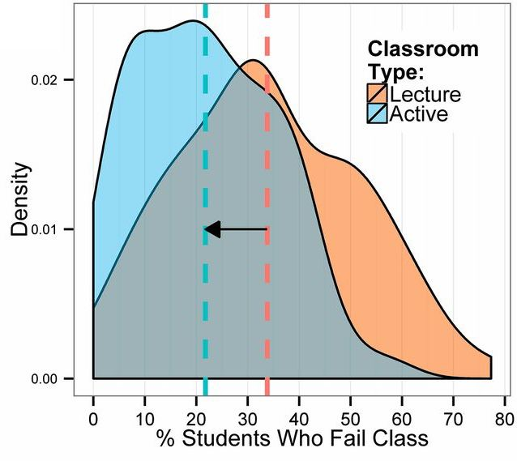
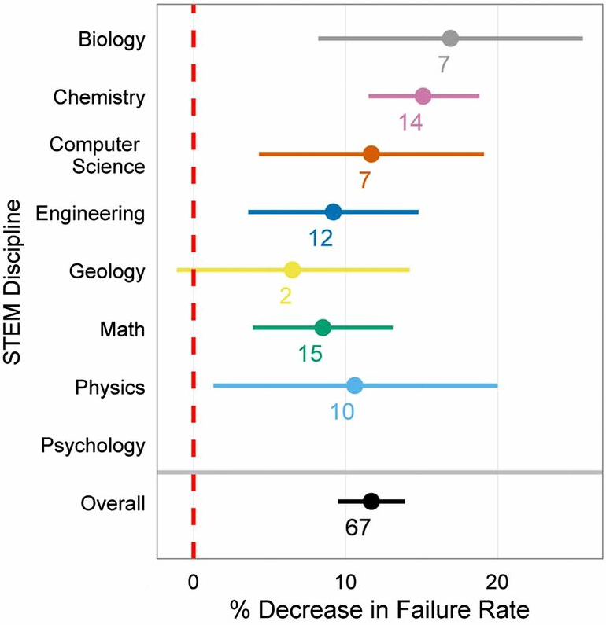
Active Learning
Active-learning has shown improved student learning across STEM fields
Common active-learning techniques: think-pair-share, peer instruction, group problem solving
Freeman et al. Active learning increases student performance in science, engineering, and mathematics, PNAS 2014 111 (23) 8410-8415.

Slide 3
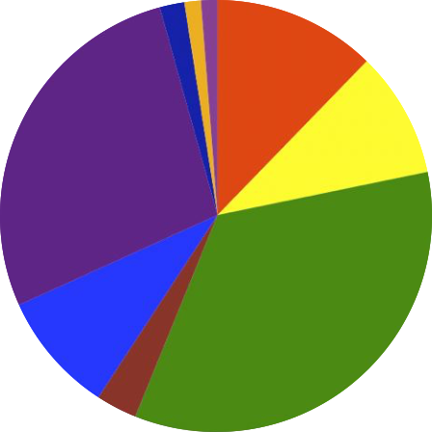
Observation and Assessment Tools
Classroom Observation Protocol for Undergraduate STEM (COPUS)
Codes how instructors and students use class time
Ex: Percentage of lecturing, posing questions, answering student question, etc.
> 2 hours or training
Lecturing
Follow-up
activity
Moving/
guiding
Teaching Dimensions Observation Protocol
Documents 46 classroom behaviors
Ex: Teaching methods, teacher-student dialog, pedagogical strategies, etc.
3 days of training
Moving/
listening
Polling
Practical Observation Rubric To Assess Active Learning (PORTAAL)
Assesses use of best practices for active-learning
Defines 21 observable behaviors that are linking to best practices
5 – 6 hours of training
Designed for non-experts and coarse-grained assessment

Slide 4
FEAL: Fine-Grained Evaluation of Active Learning (FEAL)
Fine-grained assessment of activity quality for large classes
Engagement: % of time student engaged in activity
Correctness: % of students who completed activity correctly
Easiness: Expert assessment of easiness of activity
Time required: Associate lecture time and activity time
Minimal training (1-2 hours)
Minimal interruption on the student-instructor team engagement
Class Date: Preceptor Name: Attending Students:
Activity 1
Simple Description: |  |  |  |  | Notes
Lecture Time: Activity Time:
 | <50% | 50%-70% | 70%-90% | >90%
Engagement (students)
Engagement (time)
Correctness
Easiness | Very difficult | Slightly difficult | Average | Very easy

Slide 5
FEAL: Fine-Grained Evaluation of Active Learning (FEAL)
Student engagement
Percentage of students engaged during the activity
Measured by both time and number of students
Aggregated into a single engagement metric
Engaged students will:
Read activity requirements, refer to relevant concepts, write code on paper/whiteboard, discuss with group members
Fuzzy (i.e., level-based) assessments ease efficiency of completing form
Collected data is aggregated across entire class
 | <50% (level 1) | 50%-70% (level 2) | 70-90% (level 3) | >90% (level 4) | Student Attendance | Aggregate
Engagement (students) | 0 | 35 | 49 | 48 | 132 | 80.2% × 80.5% = 64.5%
Engagement (time) | 0 | 47 | 18 | 67 | 132
Correctness | 0 | 27 | 93 | 12 | 132 | 77.3%
Easiness | 0 | 8 | 112 | 12 | 132 | 3.03

Slide 6
Concept Categorization
Concept | Sub-concepts
Basics | variables, ASCII encoding, operators, scanf, printf
Loops | for loops, while loops, nested loops
Conditions | if-else, switch
Functions | functions, arguments, return values
Pointers | single pointers, double pointers, dereferencing
Arrays | integer arrays, floating point arrays, char arrays
2D Arrays | numeric matrices, char matrices
Strings | strings
Structures | structures
Linked Lists | single linked lists, doubly linked lists
Recursion | recursive functions

Slide 7
Introductory Programming Course
Student Population
4-year university (University of Arizona)
Mostly freshman College of Engineering students
Some senior and graduate students (primarily outside College of Engineering)
Instruction Team
2 instructors
8 preceptors
2 graduate students
6 undergraduate students
5-6 tables per preceptor
Difficult to assess quality and effectiveness of activities

Slide 8
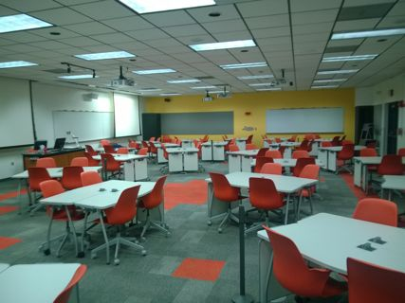
Collaborative Learning Spaces
Collaborative learning spaces (CLSs) are purposefully designed and equipped to facilitate active learning
Largest CLS at University of Arizona
Maximum capacity of 260 students
Organized in round tables of up to six persons
Tables have 1-2 whiteboards and a table number
CLS is equipped with over 20 screens placed around the room so that projected material is visible from every table and angle

Slide 9
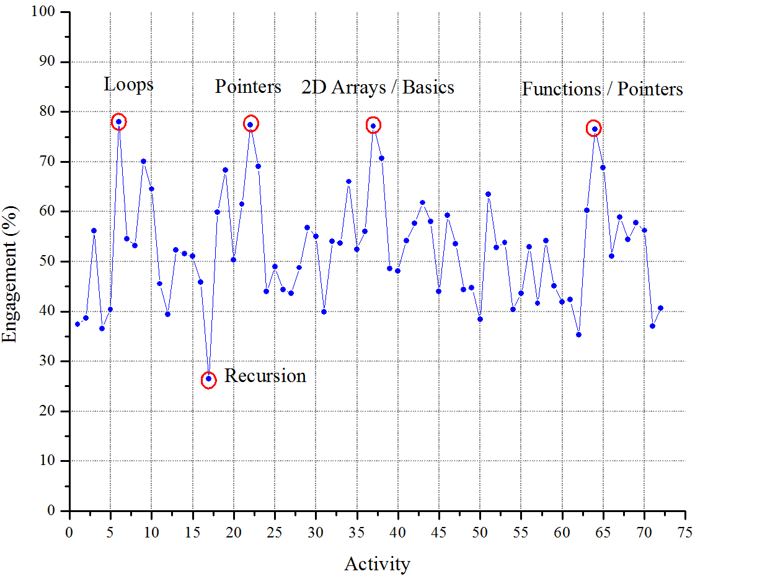
Engagement for all Activities Throughout Semester
Spikes in engagement: First activity on each topic
Recursion activity is an outlier: Analysis of activity requirements were not well design (i.e., students did not have a clear deliverable)
Engagement in larger than appears: Aggregate of time and number of students makes % look small.
Ex: 90% of students engaged for 90% of the allocated time is an overall engagement of 81%.

Slide 10
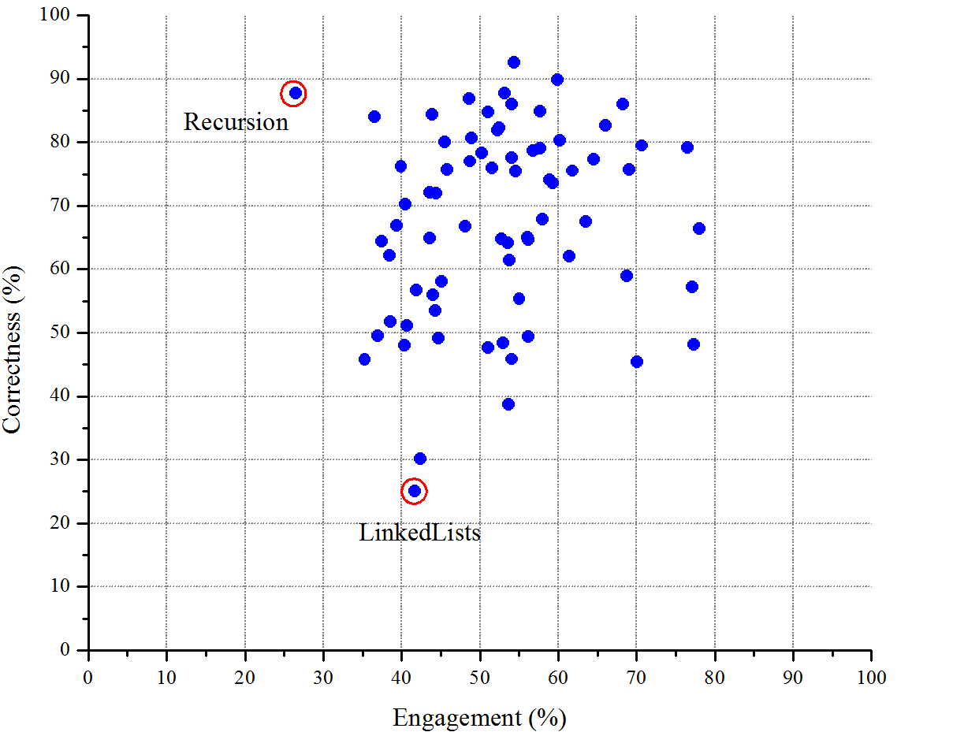
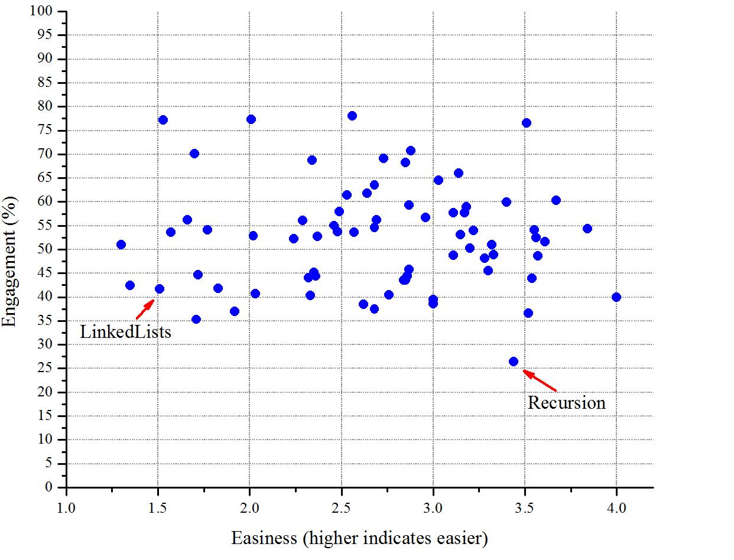
Engagement as a Function of Correctness and Easiness
On the right track: Desirable that engagement vs. correctness is in the upper right quadrant
Engagement vs. Correctness
Engagement vs. Easiness
Focus on outliers: Outliers generally indicate activities that are not well designed.

Slide 11
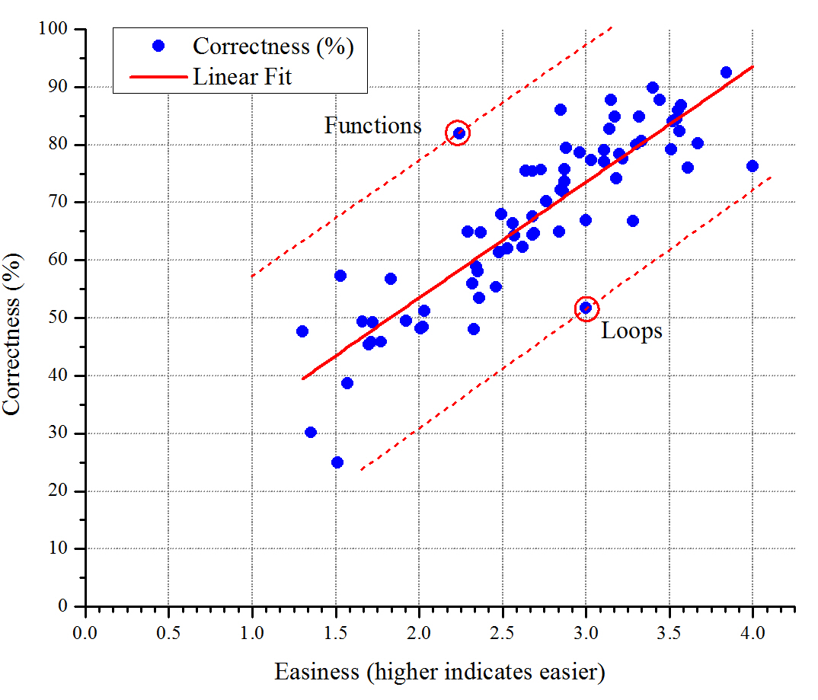
Easiness vs. Correctness
Last activity for that class day, and students already completed several similar activities
No real surprises (as expected), although there are a couple outliers

Slide 12
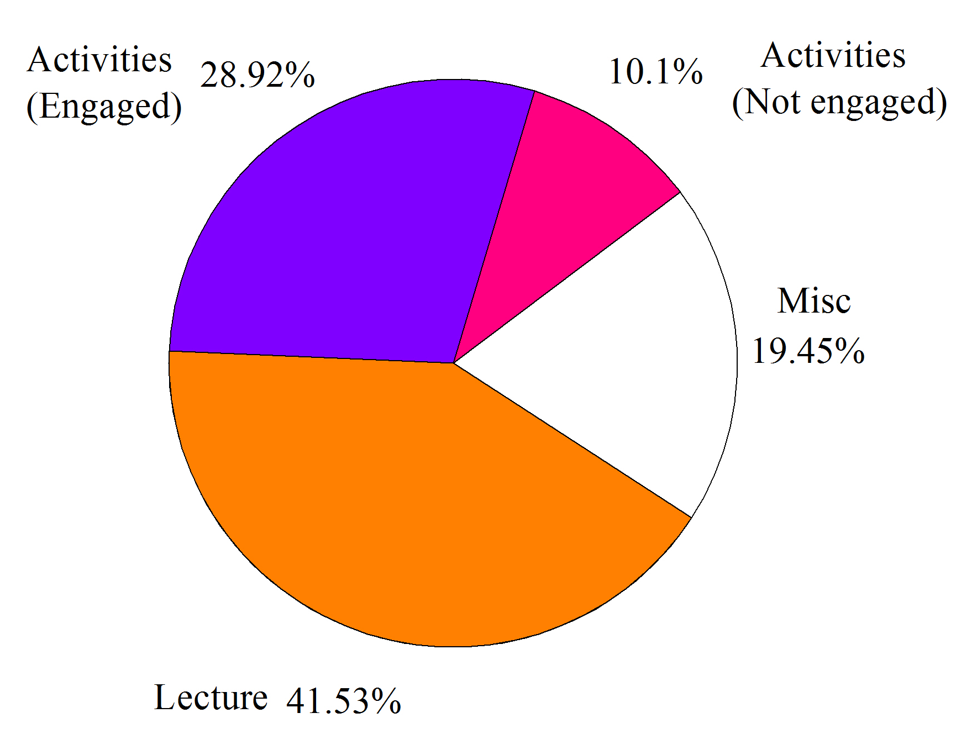
Breakdown of Class Time
FEAL provides a similar breakdown of class time as COPUS
At a coarser granularity
In this class, the instructor used a more blended teaching style.

Slide 13
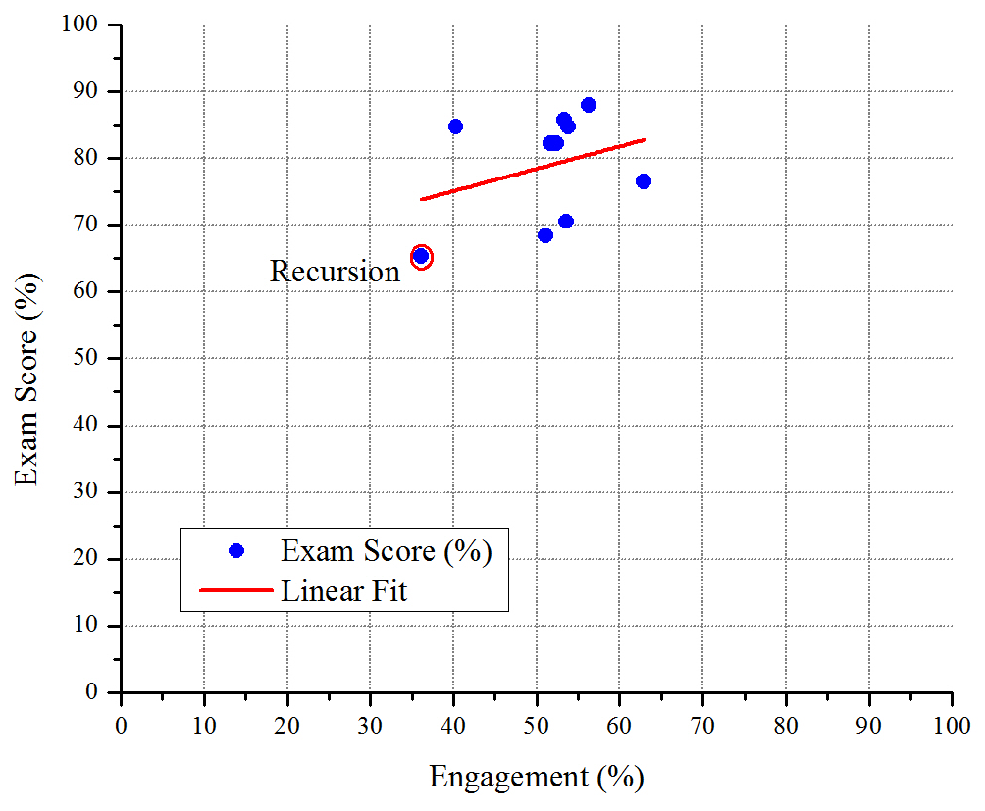
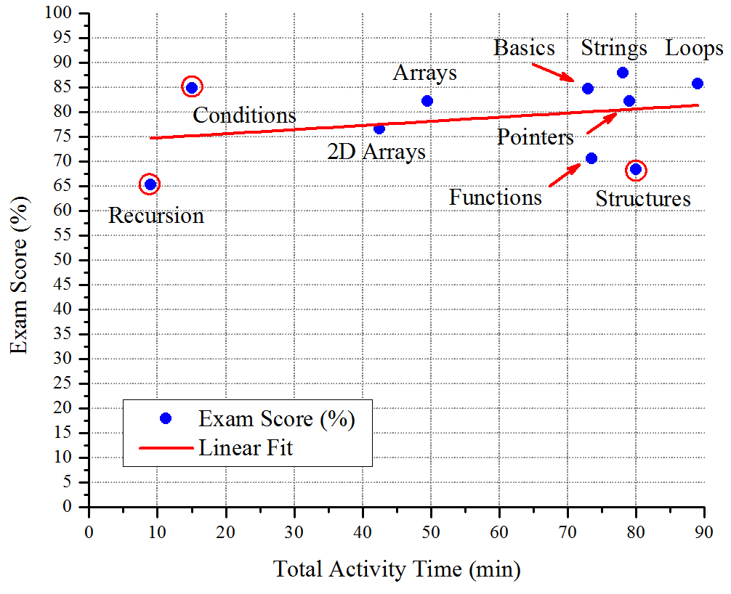
Relation to Student Performance on Exams
Slight positive correlation of both engagement and total activity time with exam scores
Engagement vs. Exam Score
Activity Time vs. Exam Score
Recursion coverage improvement: Clear need for more and better designed activities on recursion aligned with exam expectations

Slide 14
Future Work
Additional analysis of activity
Incorporate Bloom's taxonomy to code the intention of the activity
Add data for instructor’s goals for easiness and correctness
Optimize implementation of FEAL form
A few preceptors needed > 2 minutes to complete form for each activity
In second semester 50% required < 1 minute, 50% required 1-2 minutes
Due to need to average data across tables
Revise form to avoid needing to average table during class
Develop mobile app to facilitate collection
And possibly provide real-time data to instructor
Need to assess and account for inter-rated reliability

Slide 15
Thank You, Gracias, Ευχαριστώ, Merci, Tak, ありがとう, Kittos

